Slide 1
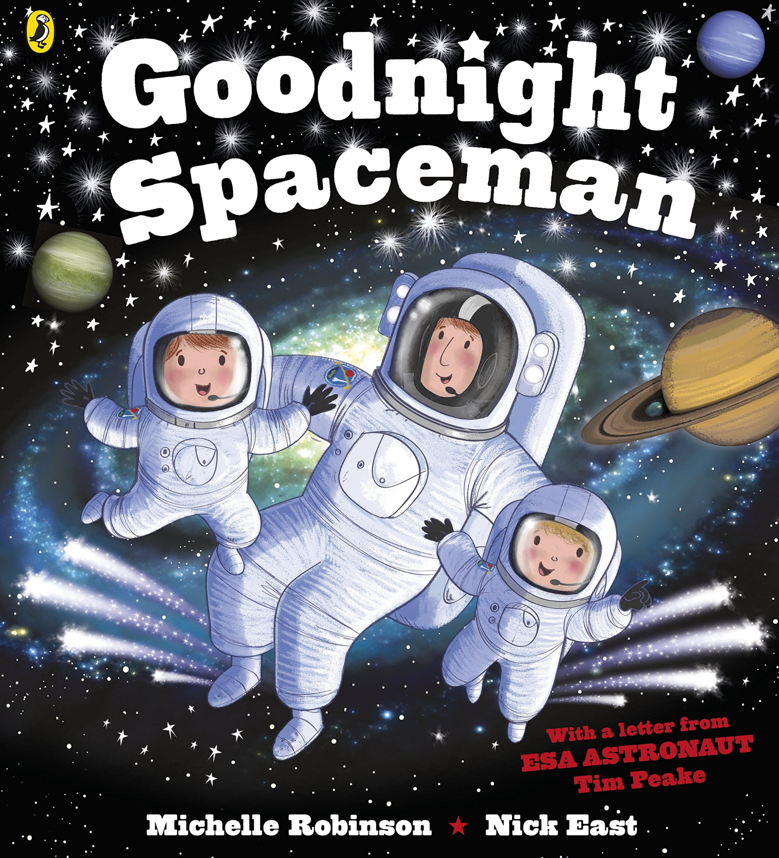
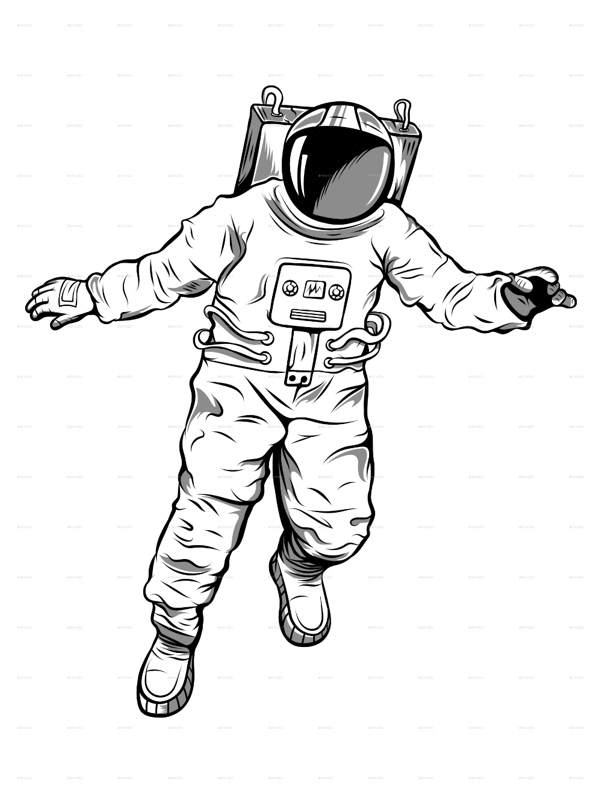
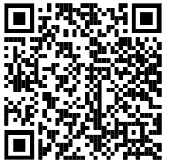
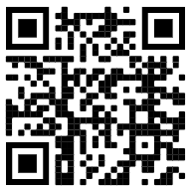
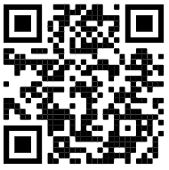
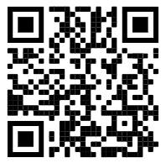
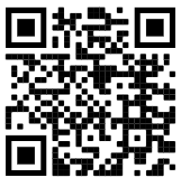
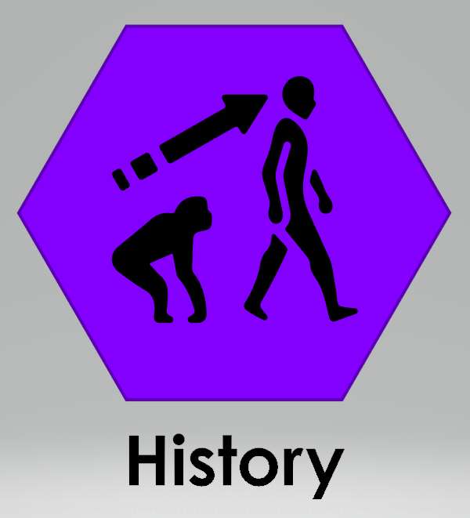
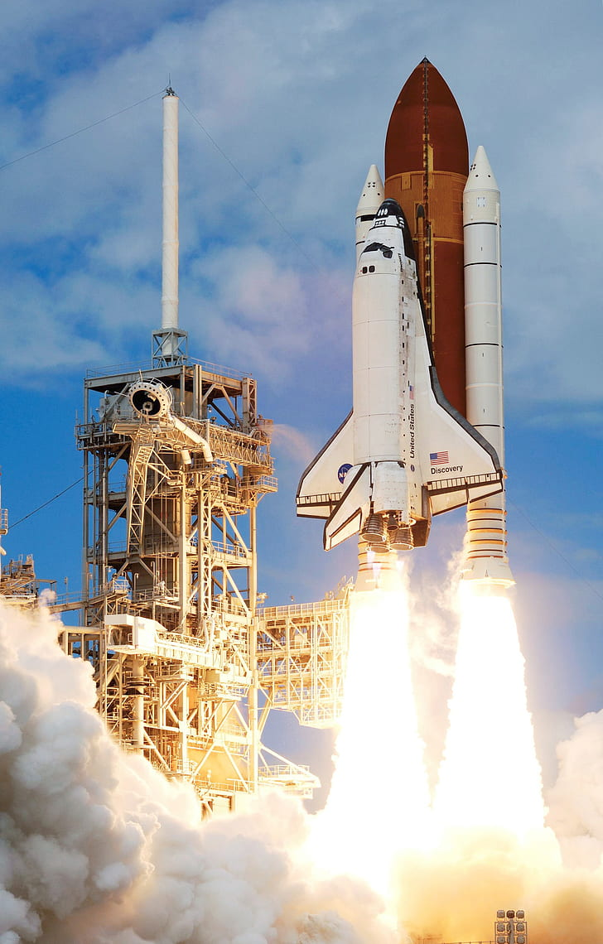
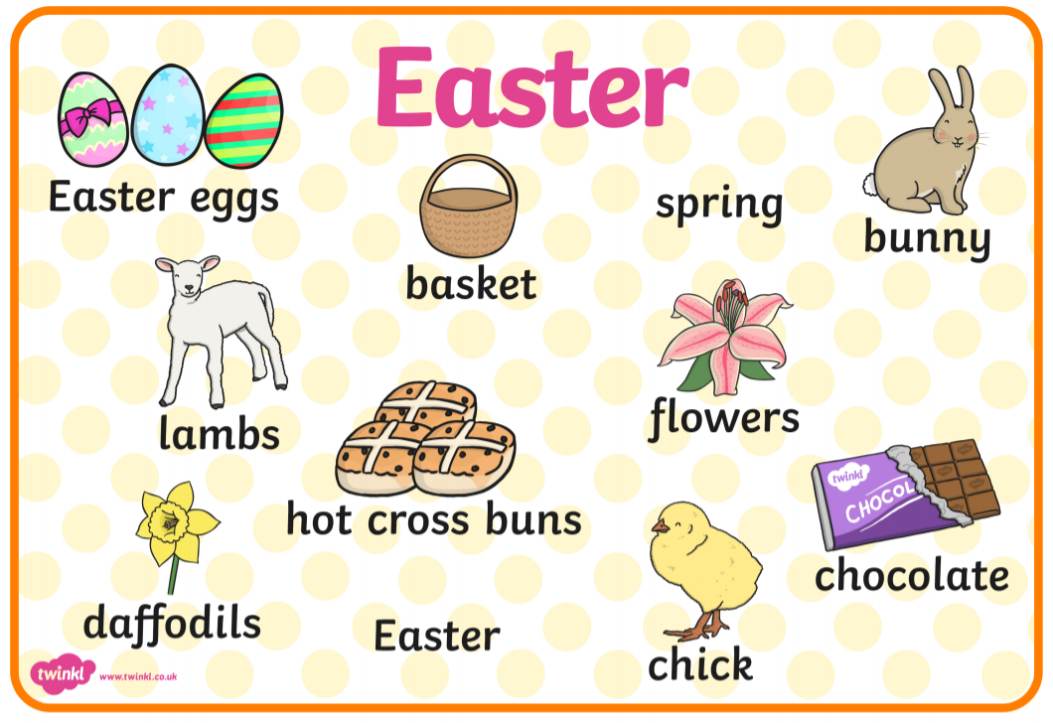
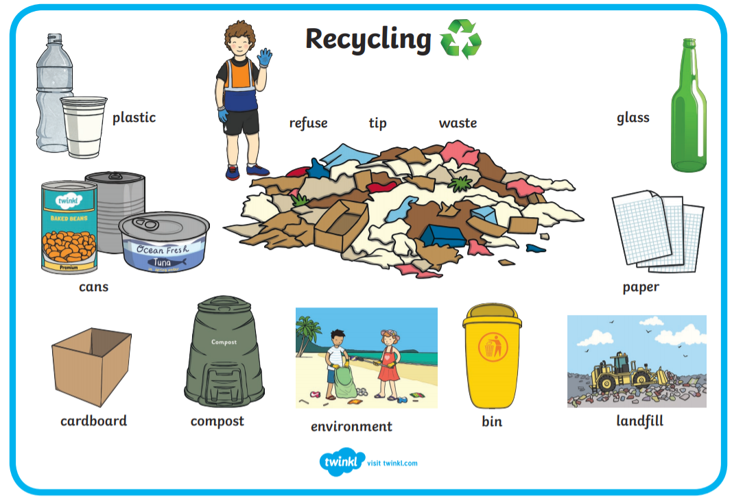
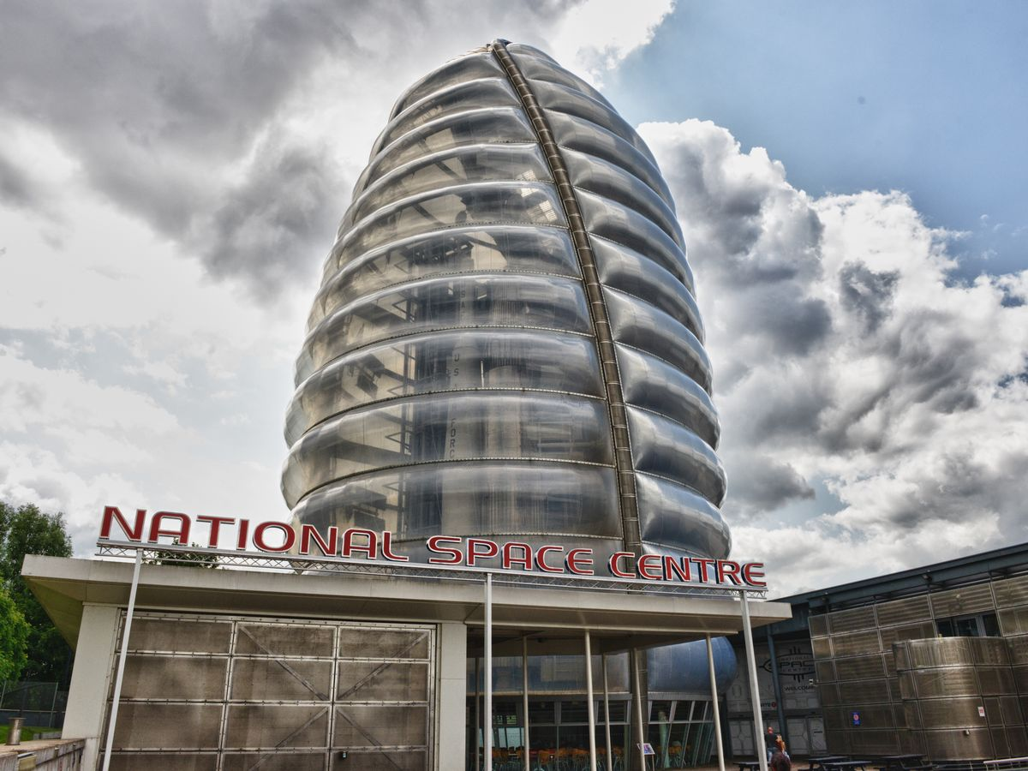
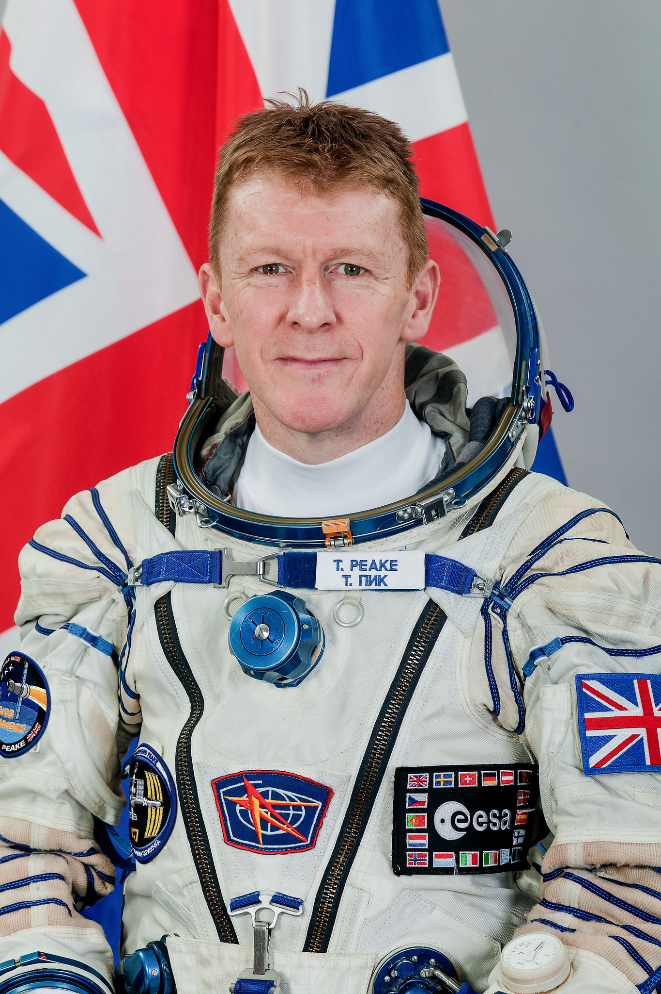
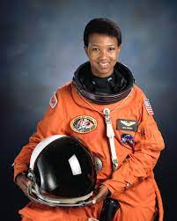
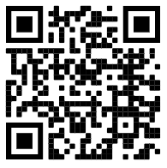
F2: Spring 2: Adventure Above and Under the Clouds (Hawthorn / Rowan)
Week 1: What is above the clouds? | Week 2: What is an astronaut? | Week 3: What is a rocket? | Week 4: What is recycling? | Week 5: Why do we celebrate Easter?
The Sea of Tranquility / Goodnight Spaceman / Look Up
Possible learning experiences:
Immersive moon reading experience.
What is the moon? What is an astronaut?
Viewing footage of Apollo 11 and the first moon walk (comparing tv images to today)
Building and making rockets
Rocket launching (thurst / gravity)
Bottle cap experiment (thrust / gravity)
Somebody Swallowed Stanley
Possible learning experiences:
Sorting materials - recyclable, biodegradable, non recyclable.
Litter walk of local area using maps to direct.
Writing a litter song / poem and perform.
Independently access the features of a non-fiction book.
We’re going on an egg hunt
Possible learning experiences:
Learning about Easter / signs of spring
Outdoor numbered egg hunt
Designing repeating patterned egg designs.
Design a parachute to save an egg.
We are Word Collectors!
Key Vocabulary:
Moon, space, stars, planet, clouds, air, Astronaut, helmet, spacesuit, boots, belt, back pack, visor.
Gravity - force that pulls objects toward each other. Earth's gravity is what keeps you on the ground and what makes things fall.
Thrust is the force which moves the rocket through the air, and through space.
Recycling is the process of converting waste materials into new materials and objects.
Can you check your recycling at home? Is it sorted correctly?
Rocket launch - this is when a rocket takes off towards space.
Scan to visit the National Space Centre in Leicester.
Tim Peake
Mae Jemison
Jigsaw: Dreams and goals: Setting a goal!
Mental Well being: What does it mean to feel proud?
Everyone’s Welcome: Blue Chameleon
Tim Peake was the first British Astronaut in Space.
Mae Jemison was the first black woman astronaut in Space.
Spring | Summer | Autumn | Winter

Slide 2
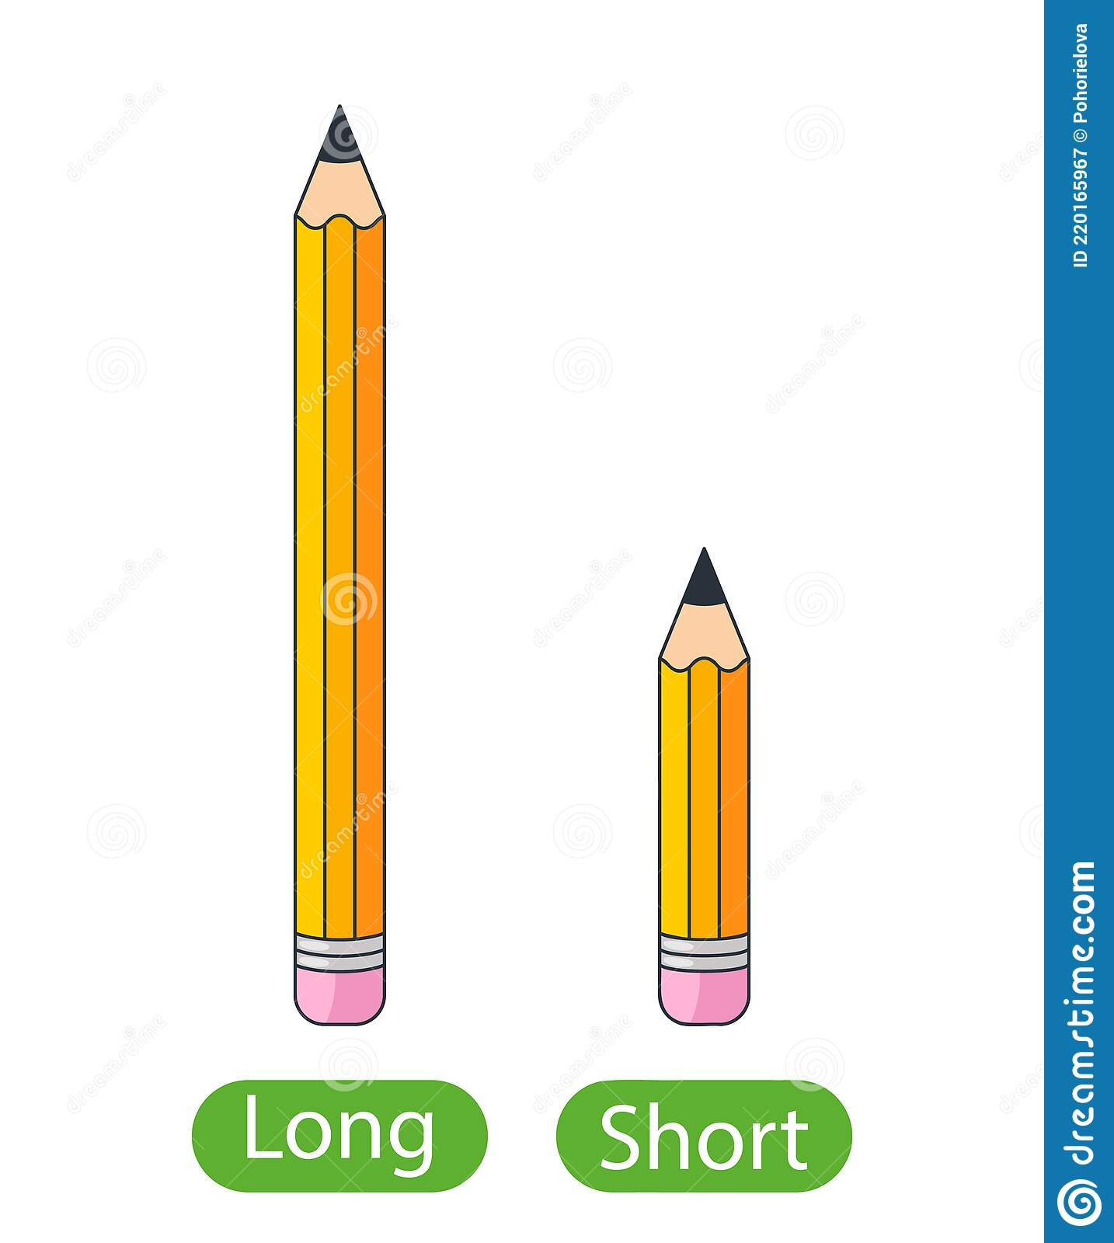
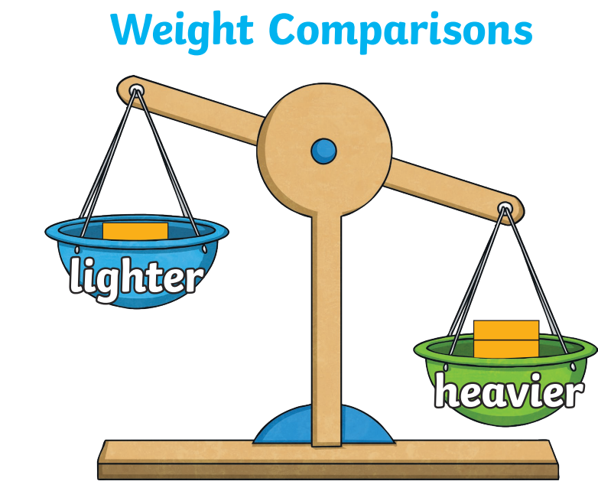
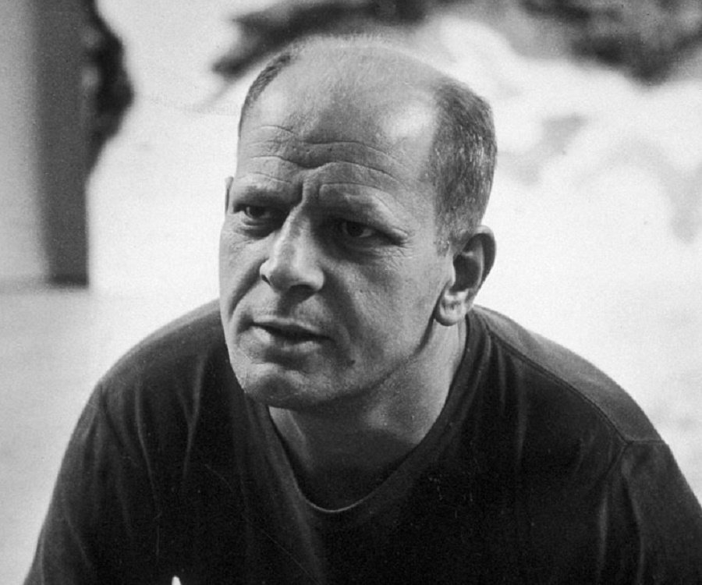
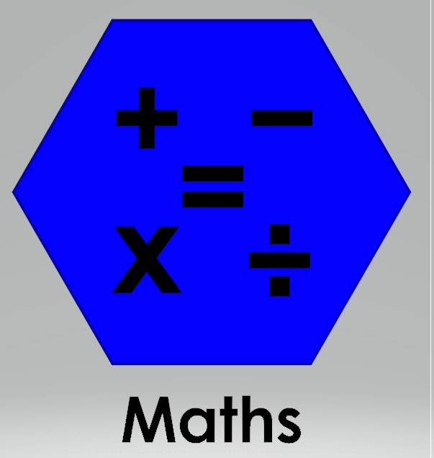
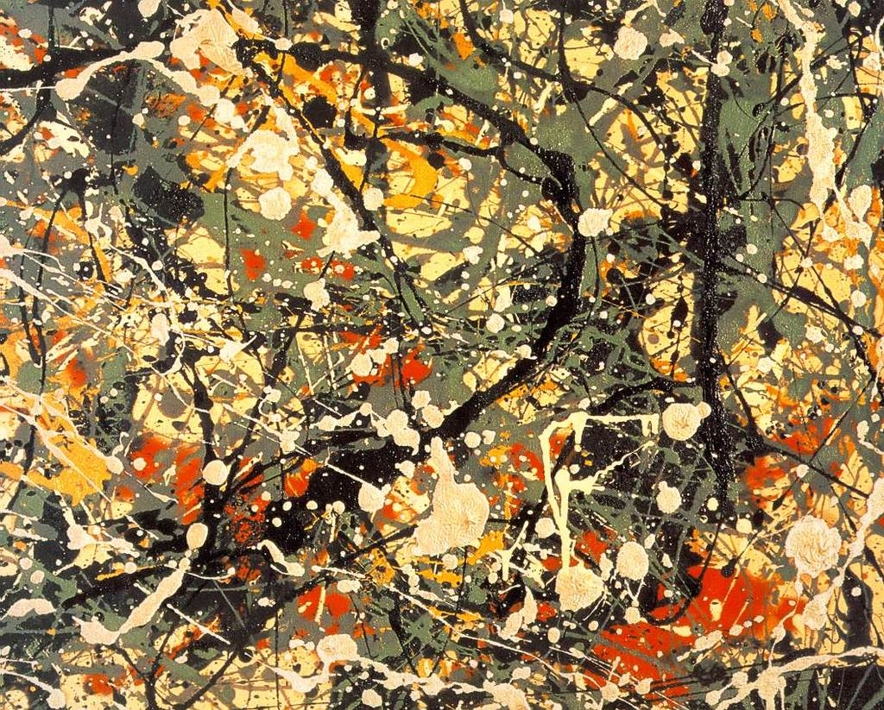
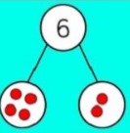
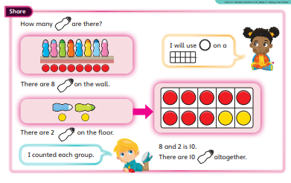
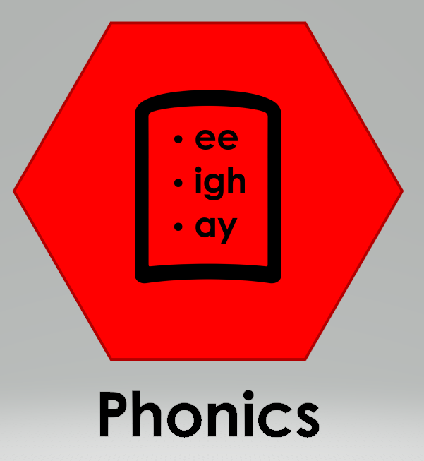
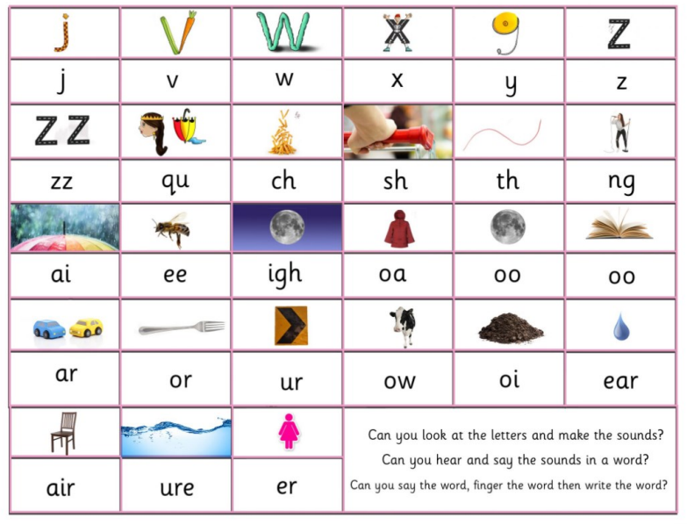
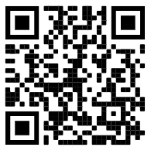
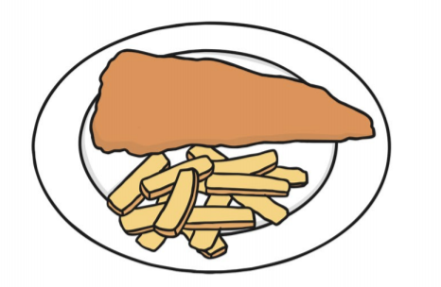
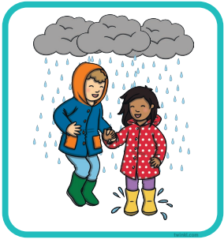
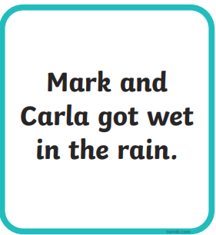
Physical Development: Gym: using equipment and climbing: I can move across large equipment showing strength and balance.
Measure: Measure: Length and weight
Expressive Arts and Design:
Painting: Jackson Pollock
Music: Pitch
Rhythm - Rhythm is what makes music move and flow. Rhythm is made up of sounds and silences.
I can sing broadly in tune with a limited pitch range.
I can create music, and suggest symbols to represent sounds.
I can record and comment on my voice and others.
He was an abstract artist which means he used shapes and colours rather than painting real things
Pollock invented ‘paint dripping’. He used different tools to drip, pour and splatter paint onto the canvas from above.
Part whole model
The whole is 6
Subising
Religious Education
Celebration: Why do hindu’s celebrate Holi?
Signs of Spring: What is spring?
Looking for the signs of spring on a spring walk: Going on a spring hunt!
Ipads; take photos of the signs of spring using a check-list.
The Easter Story: Who is Jesus?
We will learn about why we celebrate Easter.
The part is 4.
Look and say the amount straight away.
The part is 2.
We will be exploring painting using tools to drip, pour and splatter.
Collaborative painting - movement and feeling to music and creating a space backdrop.
Maths: Number bonds to 10
Questions to ask at home:
Can you see any number spot patterns? How can you use it to subitise and count the full amount?
Literacy: Phonics (word reading)
Scan to hear Phase 3 sounds.
Literacy: Writing
Begin to orally compose and write a simple sentence with support
Spell to write VC, CVC and CVCC words independently using Phase 2 and phase 3 graphemes.
Spell some irregular common (tricky) words e.g., the, to, no, go independently.
Orally compose (say) a phrase /sentence.
Tap, clap, stomp.
Count how many words.
Say first word / robot the word / write the word.
Holds a pencil effectively to form recognisable letters. Know how to form clear ascenders and descenders.
The fish and chips are on the dish.
ascenders
b d h k l t
j p q y
Can you design and write a card for a friend?
Can you write simple instructions to make your favourite food?
Can you write a daily diary?
descenders
f
Digraph: two letters that make one sound.
Trigraph: three letters that make one sound.
Can you practise ascenders and descenders?

