Slide 1
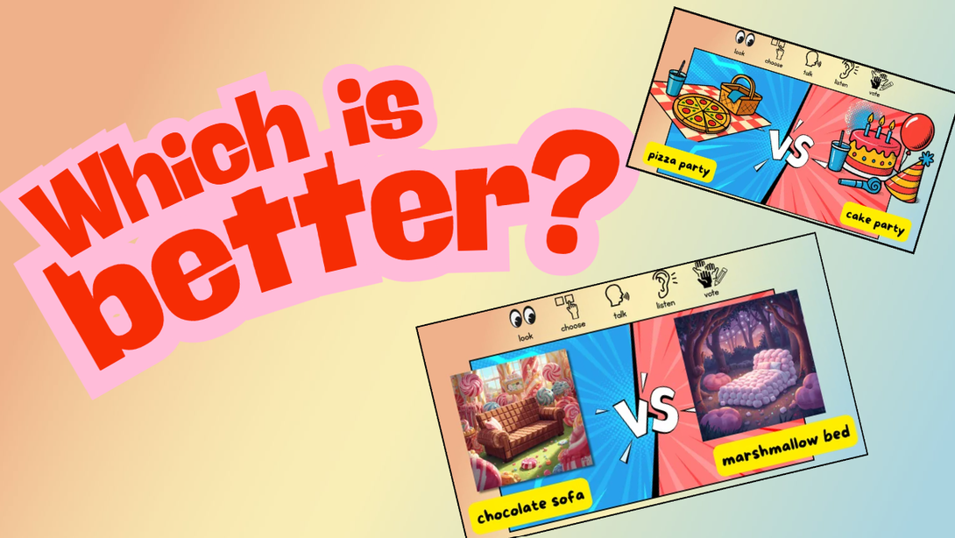

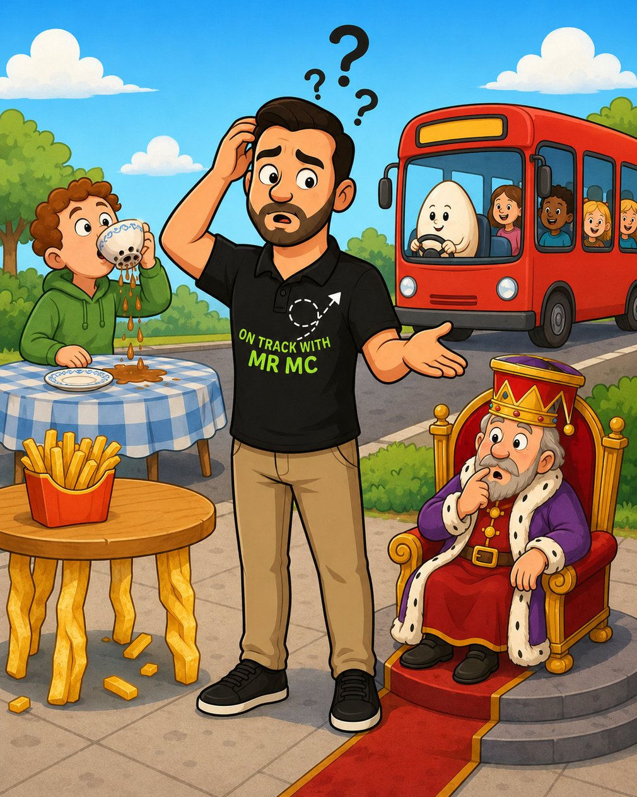
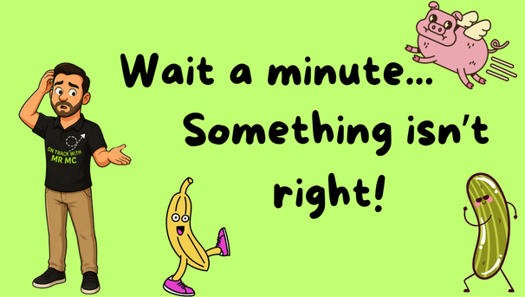
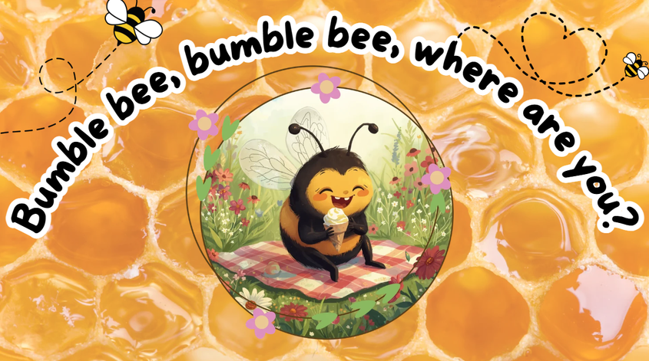
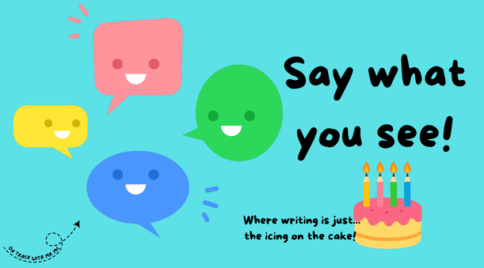
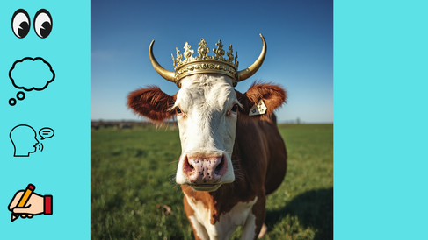
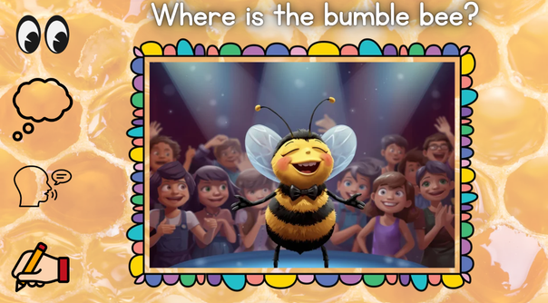
Mr Mc Starter
Writing Pack (Freebie)

Slide 2

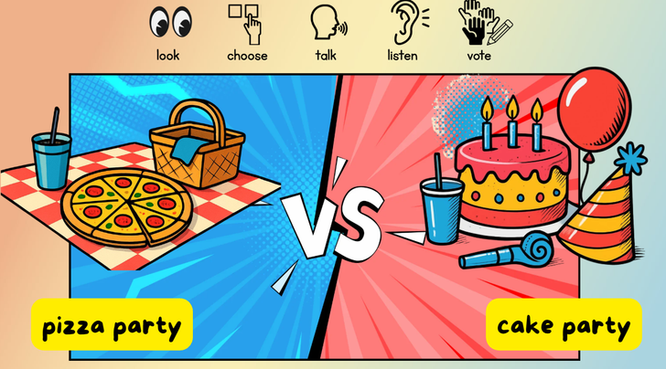
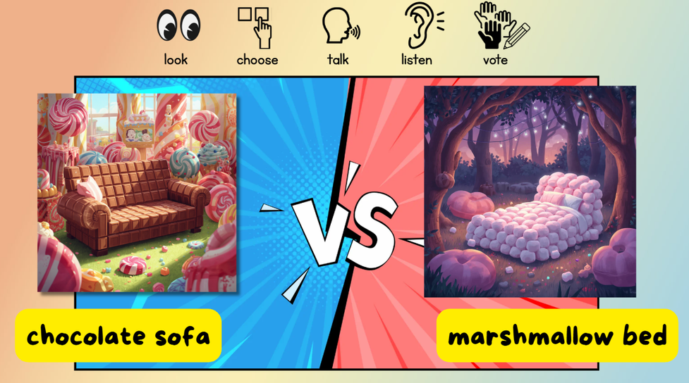
Which is
better?

Slide 3







How it works...
look
choose
talk
listen
vote
1. Look carefully “What can you see?”
2. Choose a side: “Which one would you pick?”
3. Talk: Give a reason: “Why is that one better?”
4. Listen to someone else: “Does anyone think differently?”
5: Vote: decide which one wins.
I think the....
I think that the....
The _____ is better because”

Slide 4


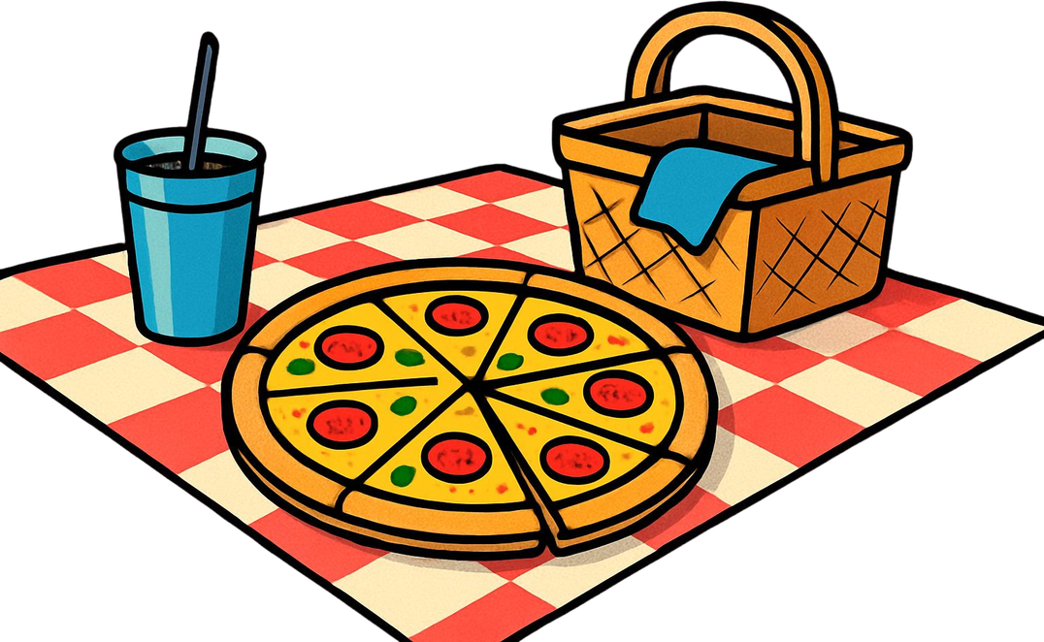
look
choose
talk
listen
vote
pizza party
cake party

Slide 5



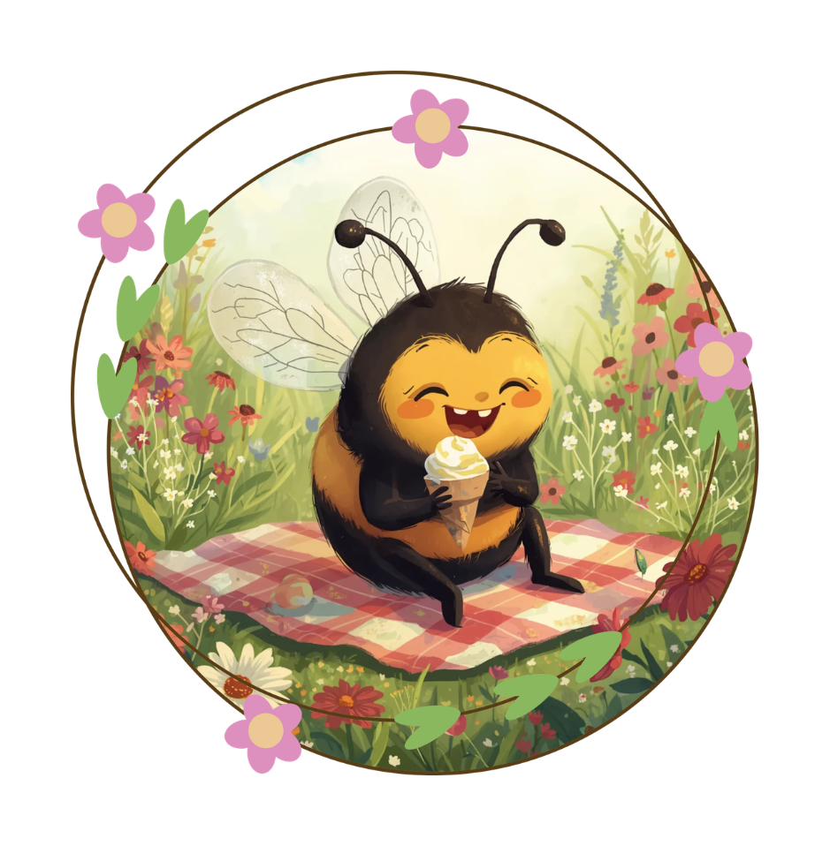
Bumble bee, bumble bee,
where are you?

Slide 6
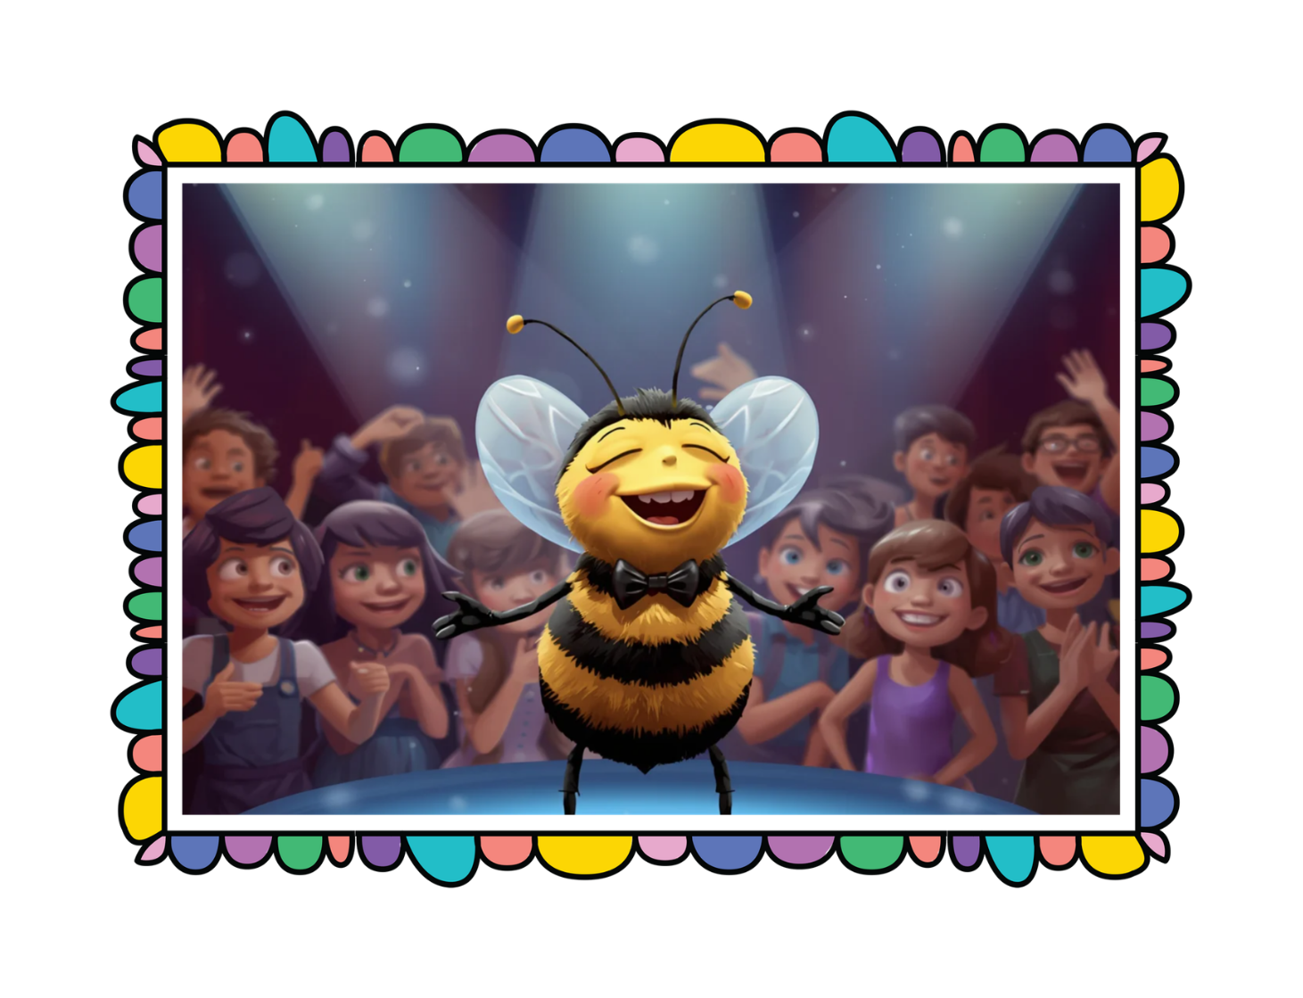



Where is the bumble bee?

Slide 7
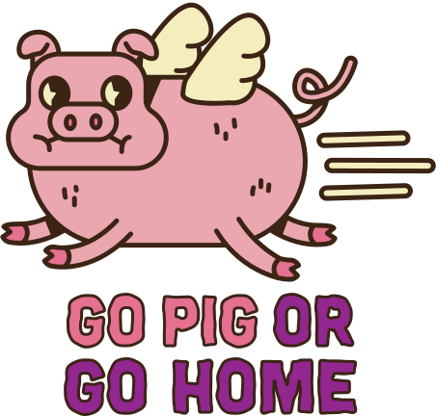



Wait a minute...
Something isn’t
right!

Slide 8
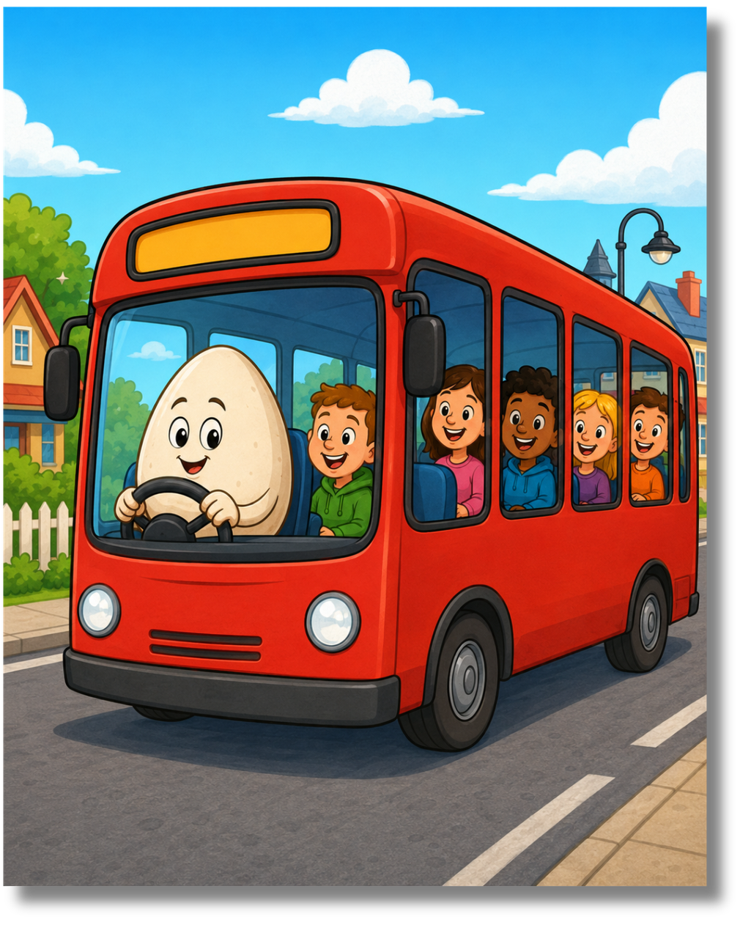
I can see that...

Slide 9


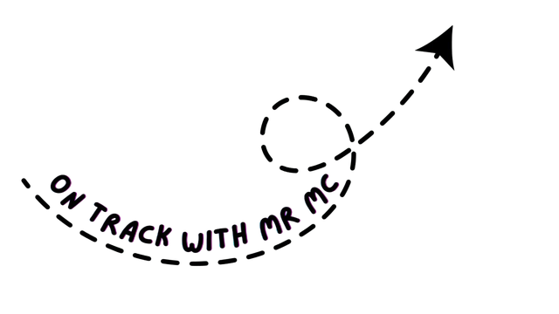
Say what
you see!
Where writing is just...
the icing on the cake!

Slide 10
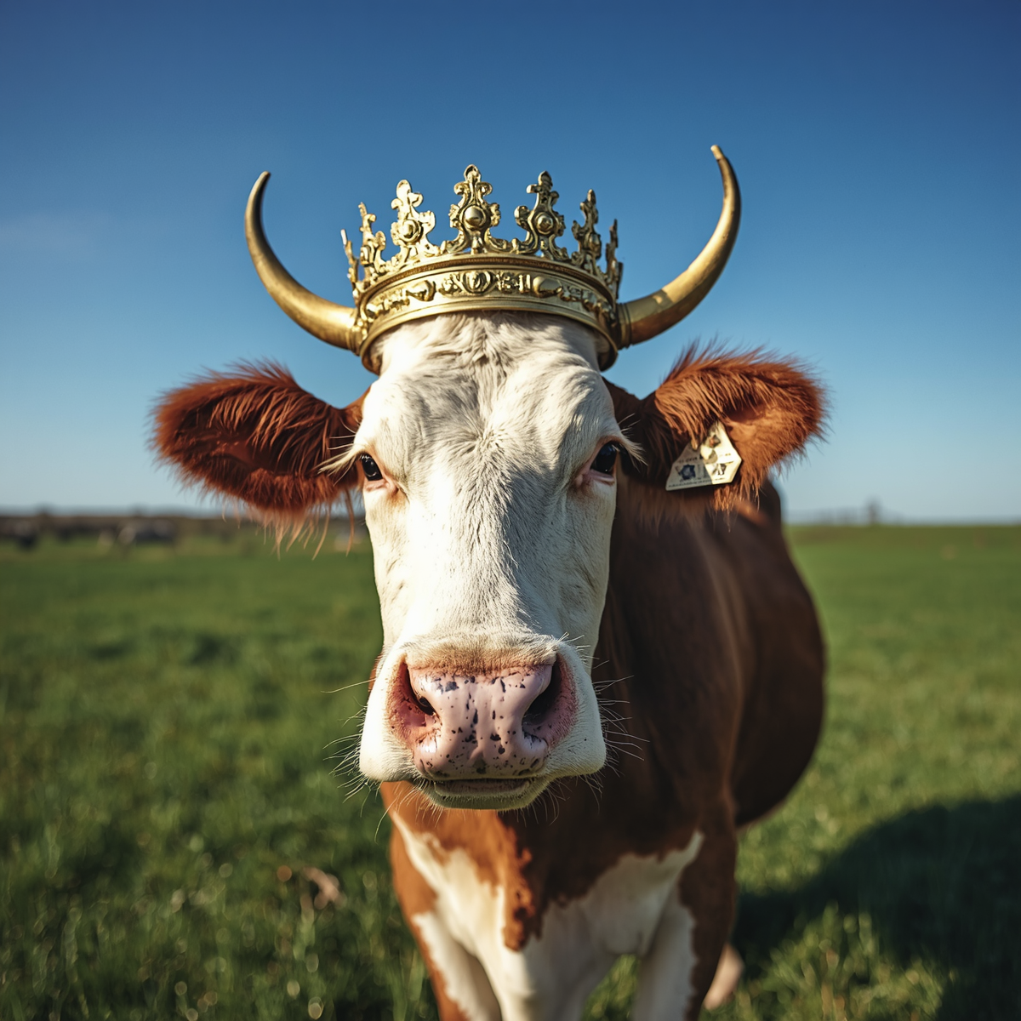

Slide 11
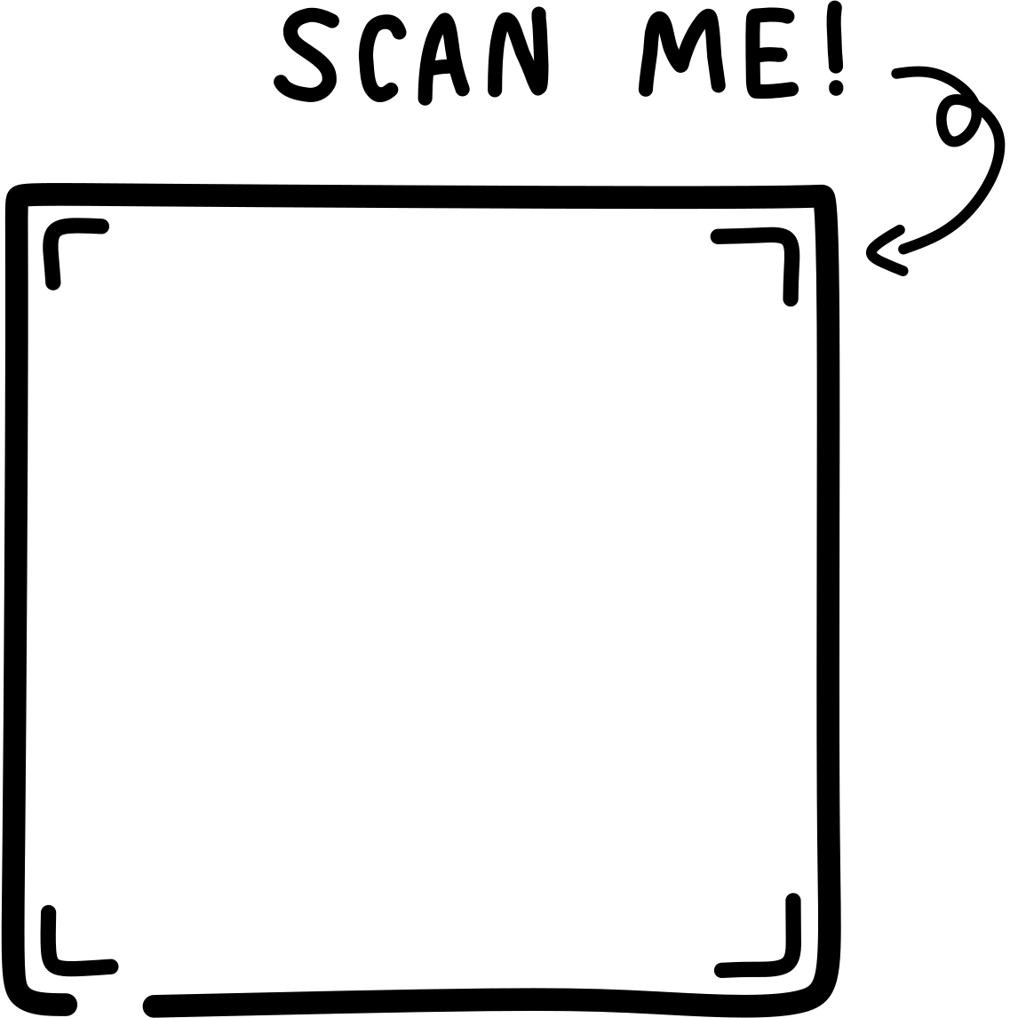
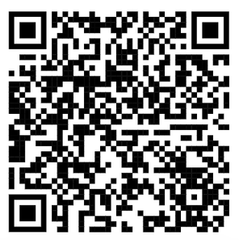
Liked this?
This is just a tiny taste of the Mr Mc Writing Packs. Inside you’ll find exciting picture prompts, ready-to-use slides and printables that get children talking first, laughing next and writing with actual ideas.
Save time
Shut the laptop
Get your weekend back
Click to explore the packs!
Click here
to explore the
packs on my store.

