Slide 1
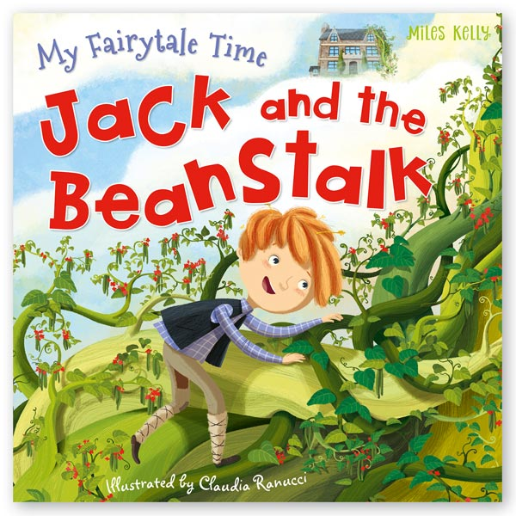
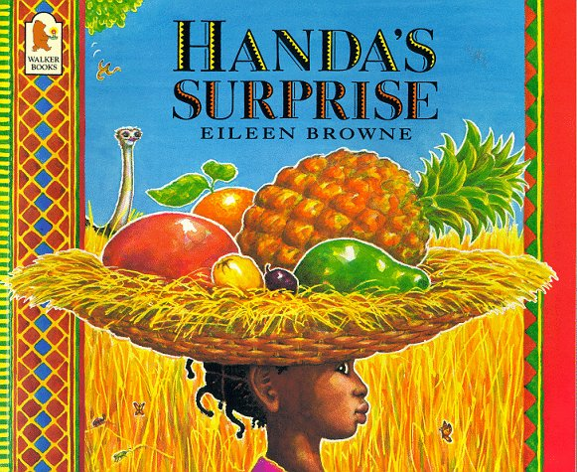
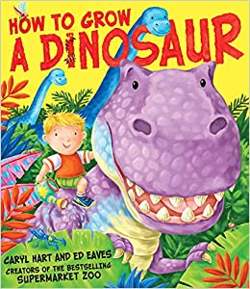
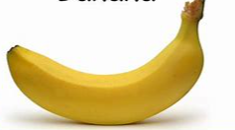
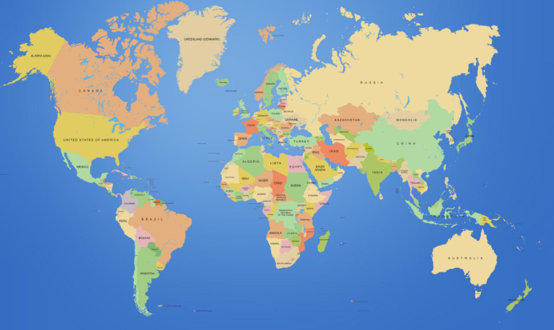
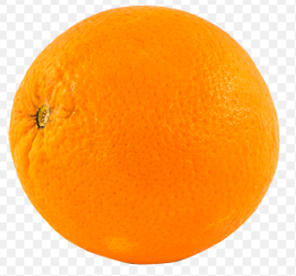
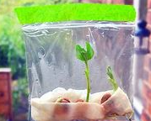
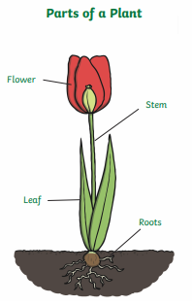
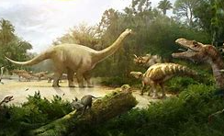
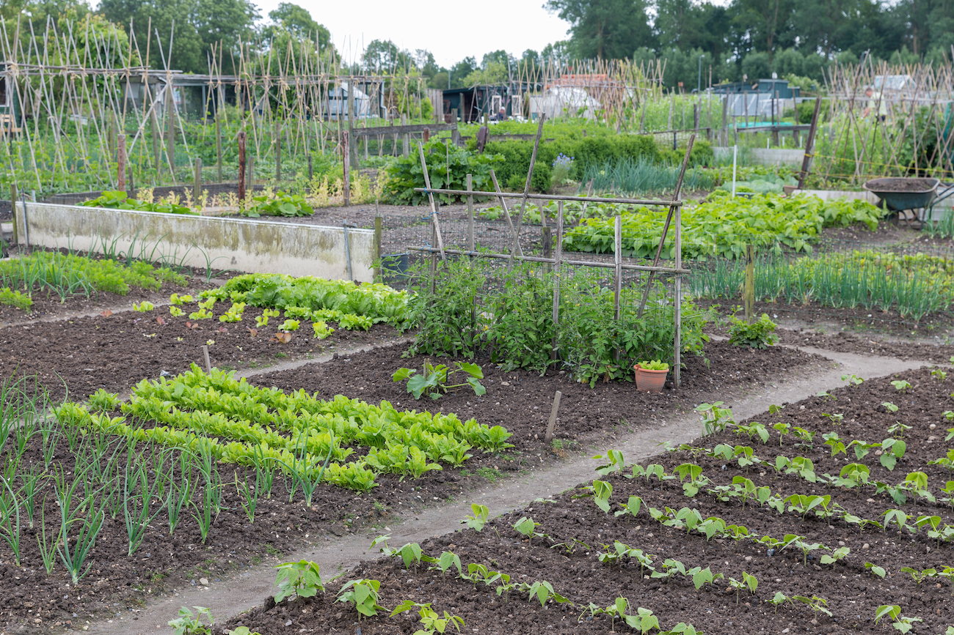
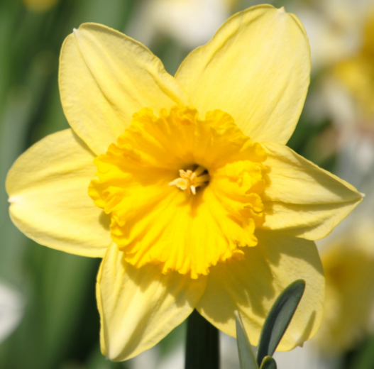
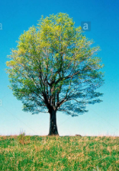
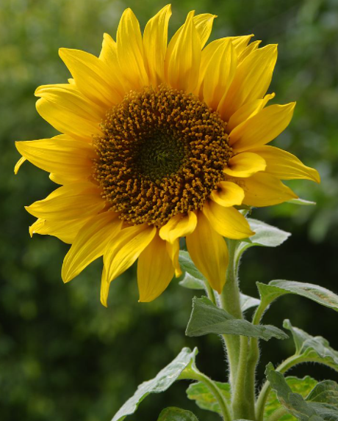
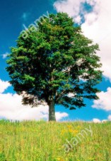
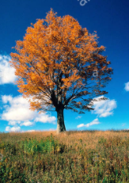
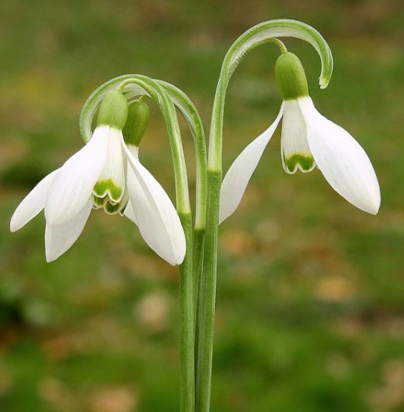
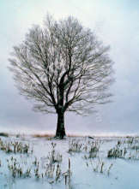
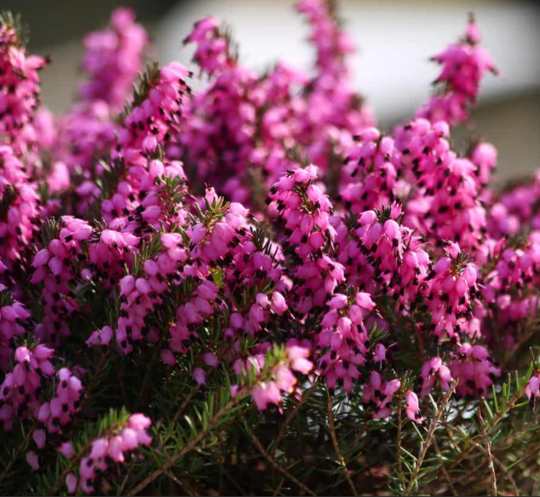
F2: Summer 1: Growing (Hawthorn / Rowan)
Week 1 amd 2: What do plants need to grow? | Week 3 and 4: Can I retell a story? | Week 5: Where does our food come from? |  | Week 6: How do we know dinosaurs existed?
Can you name the fruits you can see in your local shop? Where did they come from?
Handa’s Surprise
Possible learning experiences:
Healthy fruits and vegetables
Farm to fork - where does our food come from?
Plotting our fruit on a map of the world.
Handas Suprise | Eileen Browne | Read along | bedtime story | picture book | - YouTube
How to grow a Dinosaur
Possible learning experiences:
Immersive dinosaur scene / investigation set up.
Exploring what the world was like for dinosaurs in the past.
The Tiny Seed / Jack and the Beanstalk
Possible learning experiences:
The needs of a plant experiment
Growing plants / flowers: sunflower competition, growing a bean in a bag.
Drawing plants and flowers.
The Tiny Seed by Eric Carle || An INSPIRING Adventure! [CC] – YouTube
Jack and the Beanstalk Fairy Tale by Oxbridge Baby - YouTube
Growing vocabulary:
plant seed soil compost
grow bigger smaller shorter taller
We will be using our
curiosity, attention and
friendship character
muscles.
Decay: What happens to food when it is left over time? Take photos and talk about what happens.
We are Word Collectors!
We will visit Mrs Middleton’s allotment to harvest vegetables and grow some food in our edible garden.
Needs of a plant: 1) water 2) soil 3) light (sunlight) 4) space 5) air
Other vocabulary: seed, bean, grow, stem, shoot, roots, soil, tall, short.
roots: suck up nutrients from the soil
leaves: catch the sunlight to give the plant energy to grow
stem: the skeleton of the plant – helps it to stand tall and grow towards the sun
petal: the bright colour help to attract lots of insects
I'm a little bean - YouTube
Spring | Summer | Autumn | Winter

Slide 2
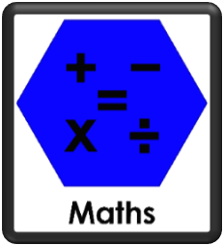
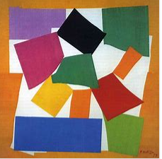
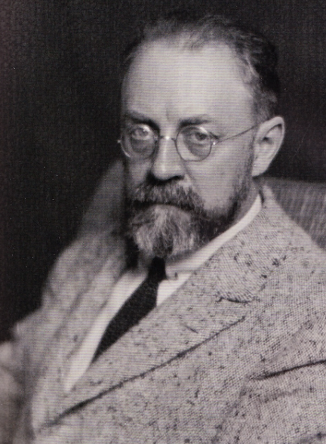
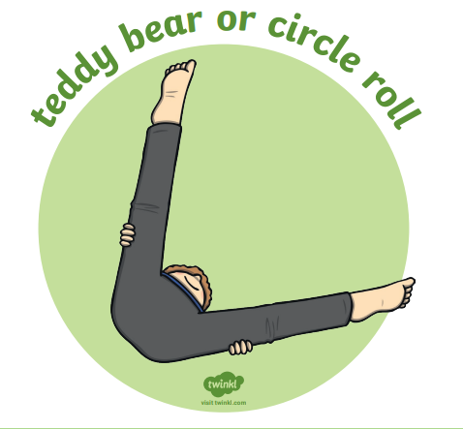
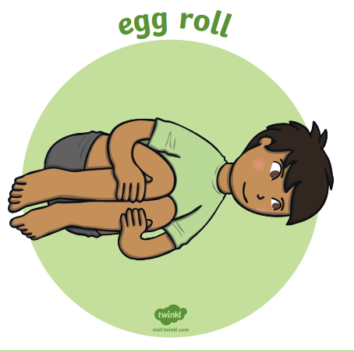
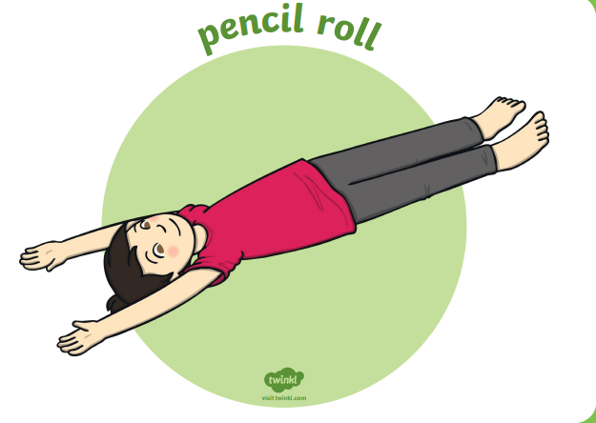
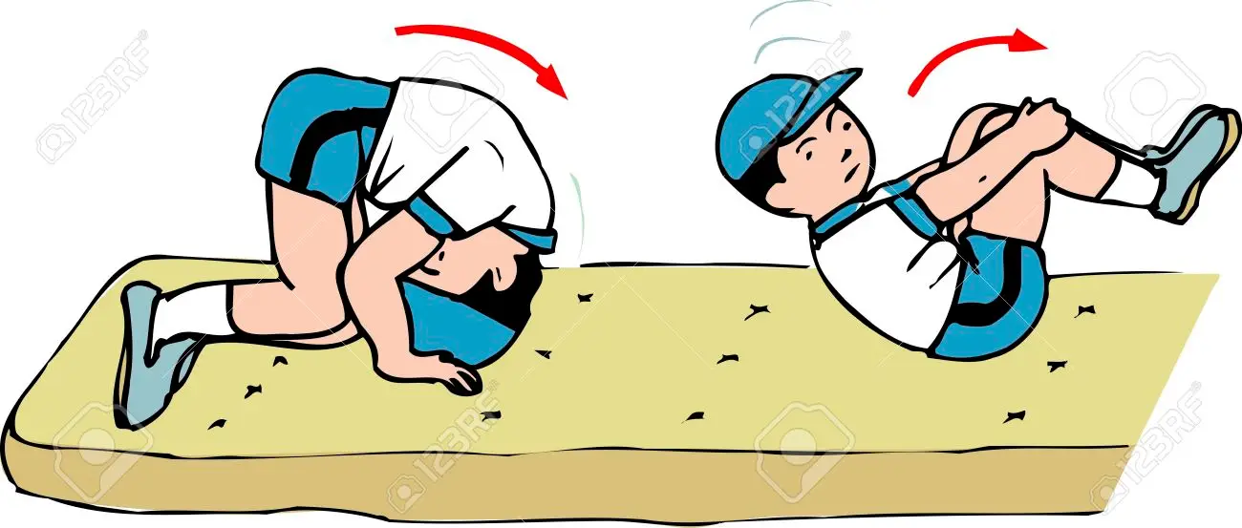
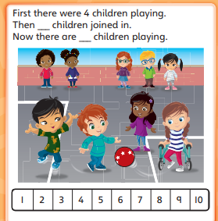
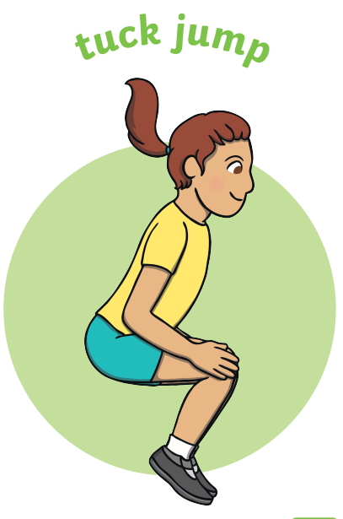
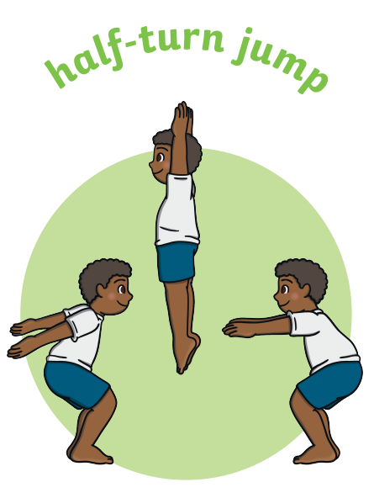
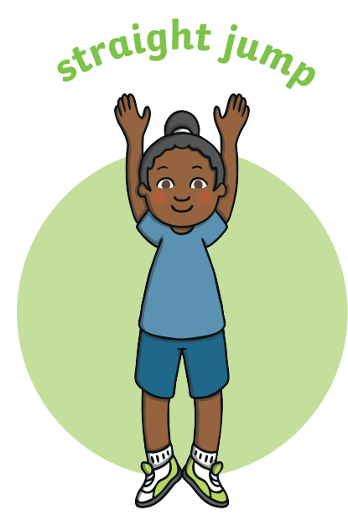
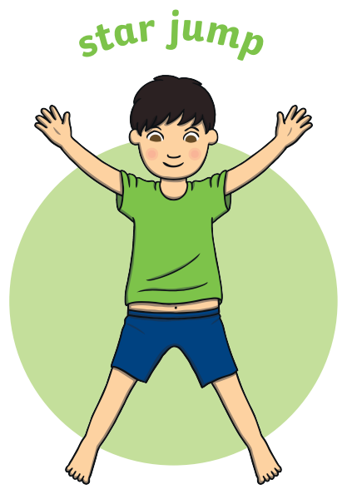
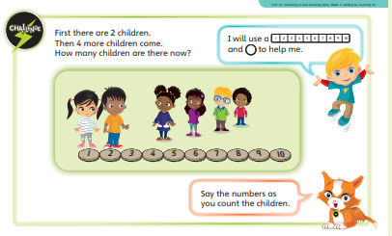
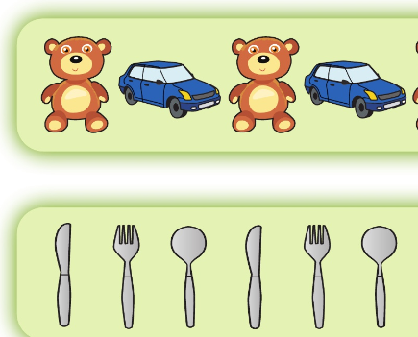
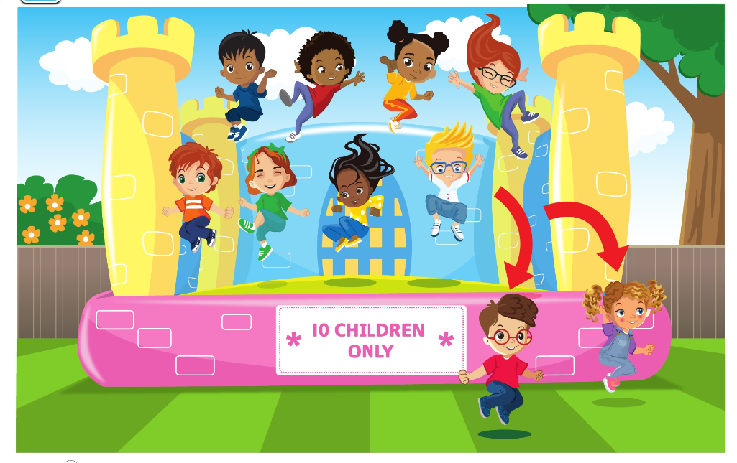
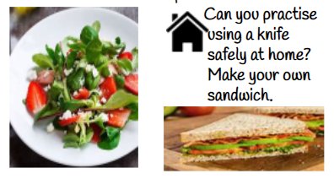
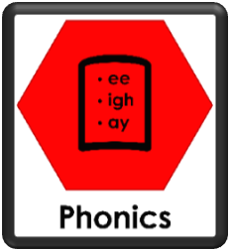
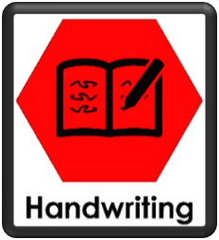
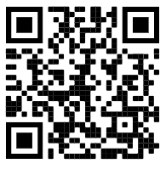
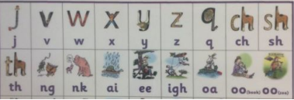
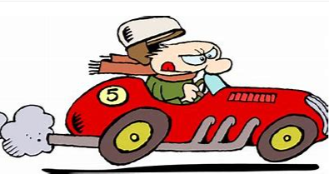
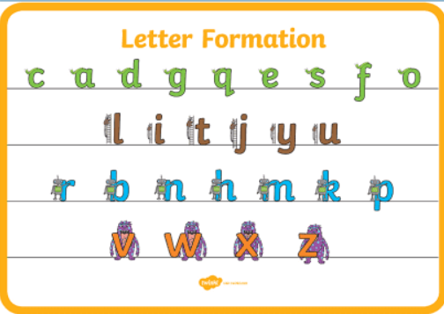
Physical Development: Gross and Fine motor Skill
Handwriting - Develop the foundations of a handwriting style which is fast, accurate and efficient.
Physical Development - PE: Gymnastics
I can confidently and safely use a range of large and small apparatus indoors and outside and in a group.
Mathematics: Number: Counting on and counting back
The children will explore addition and subtraction through counting on and counting back. Children will use a number track to practise counting the number of jumps required to move on or back rather than the actual numbers they are landing on.
Number song 1-20 for children | Counting numbers | The Singing Walrus – YouTube
Expressive Arts and Design:
Artist: Henri Matisse: The Snail collage
We will be making repeated patterns using 2D shapes in the style of Henri Matisee.
Can you make a repeated pattern with
things you find outside?
King Charles Cornation Art
We will be using our collaging skills and pattern skills from our maths to design and collage a new crown for King Charles.
Using tools to create a fruit Kebab.
We will be learning how to safely use tools to make our salad - cut chop slice
Music: Pitch
Rhythm - Rhythm is what makes music move and flow. Rhythm is made up of sounds and silences.
I can sing broadly in tune with a limited pitch range.
I can create music, and suggest symbols to represent sounds.
I can record and comment on my voice and others
forward roll
These are examples of counting on tasks we will be doing.
(Jumping Jack)
Can you draw a hop scotch and practising counting on from any number?
Each week on google classrooms we will link you to a new movement to practise at home.
Jigsaw Healthy Me: Physical health and fitness / healthy eating. We will be talking about our favourite sports, healthy foods and why sleep is important.
Using tools to create a healthy salad: We will be learning how to safely use tools to make a salad.
Exploring repeating patterns
=
Subtraction: 10-2=8
Literacy: Reading
Correctly sequence a story or event using pictures and/or captions.
Respond to questions about how and why something is happening.
Know the difference between different types of texts (fiction, nonfiction, poetry)
Literacy: Writing
Orally compose and write a simple sentence with a full stop.
The car was in a rush.
Continue to learn Phase 3 sounds
Spell words by drawing on knowledge of known grapheme correspondences.
Make phonetically plausible attempts when writing more complex unknown words.
Oral Segmenting - this is when you split a word up into its individual sounds (c-a-t). We call this ‘robot talk’.
Scan to hear Phase 3 sounds.
Orally compose (say) a phrase /sentence.
Tap, clap, stomp.
Count how many words.
Say first word / robot the word / write the word.
Form most lower-case letters correctly, starting and finishing in the right place, going the right way round and correctly orientated. Include spaces between words.
Using our phonics to help us read:
Continue to apply knowledge of blending and segmenting to reading and spelling simple two-syllable words, captions and simple sentences. How do we read?
‘We look at the letters, make the sounds and blend the sounds together’ OR if it’s a superpower word ‘We see the word and say the word@
Oral blending - this is when you blend the sounds together to say the word (cat). We use a blending arm motion from left to right to help blend the sounds together.
Can you keep a diary about what is happening to your sunflower at home?
Digraph: two letters that make one sound.
Trigraph: three letters that make one sound.
Can you practice writing the letter families?

