Slide 1
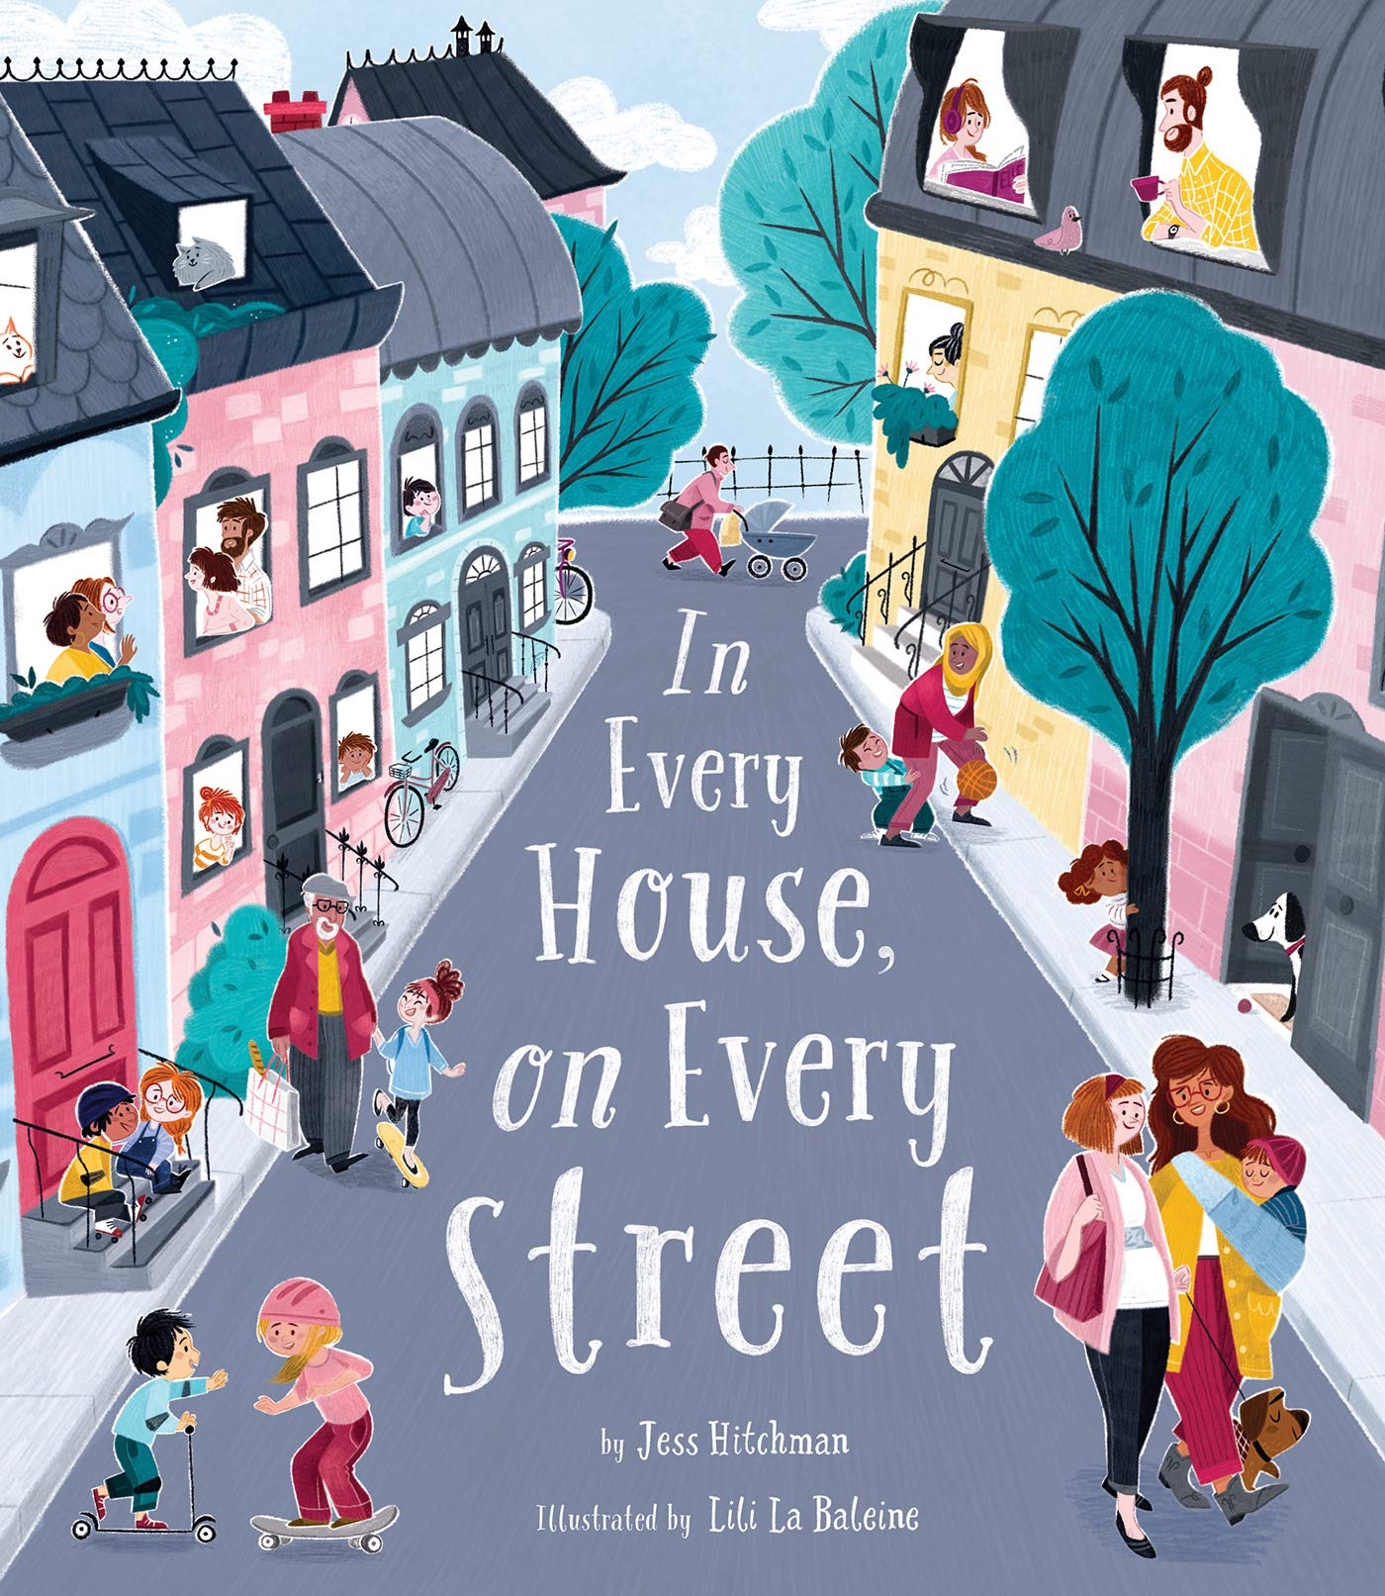
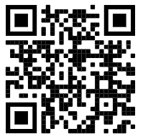
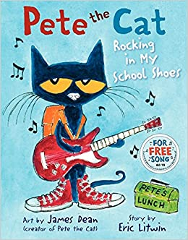
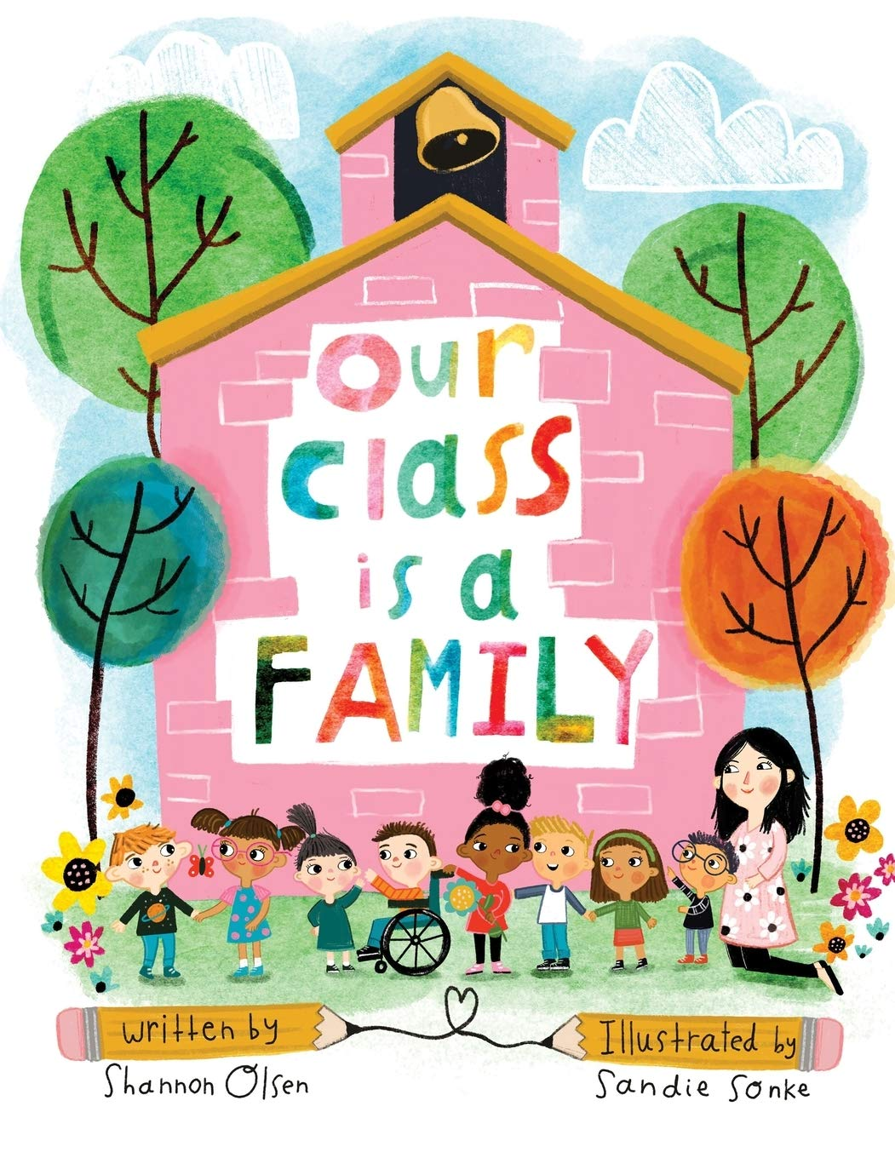
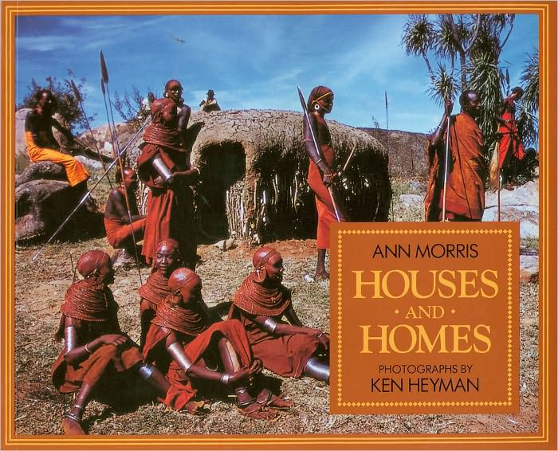
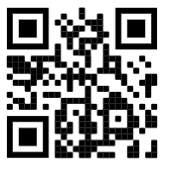
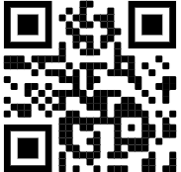
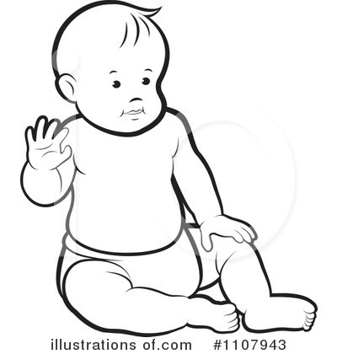
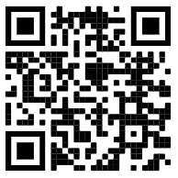
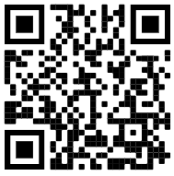
F2: Autumn 1: It’s good to be me (Hawthorn / Rowan)
1)Can I answer questions about my school? | 2) Can I talk about what makes me special? | 3)4))Can I tell you who is in my family? | 5)6)Can I talk about where I live and start to talk about my local area?
Key Books this term:
How can you learn at home?
Encourage independence -
Teach your child how to get dressed independently, including putting on their own coat and shoes.
Our Family -
Can you name the members of your family? Can you talk about the things you like to do as a family?
Create a picture of your family/ make a family tree.
What special events have you shared together as a family?
Find a photograph of your family and bring it to school to share with your class.
Please remember to bring your ‘All about me’ bag into school by the 17th September 2021.
Singing/Rhymes
Practise singing nursery rhymes.
In every house and on every street!
The Whale Song
This book will help us to learn all about different communities.
The children will be talking about their families and learning about our local community.
Vocabulary: Mum, dad, brother, sister, gran, grandad,
Baby, younger, older. Baby, younger, older. When I was a baby.. Now that I am….
Pete the Cat - Rocking in my school Shoes
This book is all about Pete and his fun day at school.
Key vocabulary: Classroom, toilet, corridor, dinner hall.
Playground, library, School, St Mary’s Fields, car park, playground, classroom, grass.
Houses and Homes around the World
The Three Little Pigs
We will be talking about the houses that we live in, exploring houses in our local community and comparing those to houses around the world.
Vocabulary: House, window, door, brick, roof, terraced house, flat, House, window, door, brick, roof, design, build.
Possible experiences:
Tour of the school, creating a photo montage of our school, rules and routines, gratitude board (5 main classroom rules), designing our own coat peg label, learning about the roles of important people in our school.
Possible experiences:
We will be talking about our families, who is special to us, sharing our ‘All about me’ bags, drawing pictures of our families and learning learn to draw a self portrait, bringing in a family photo. We will also begin talking about how we have changed, “When I was a baby”.
Possible experiences:
Learning about our local community, where we live, the houses we live in, comparing our houses to those around the world. Retelling The Three Little Pigs, investigating building materials, introducing our work bench, building a house and starting our breakfast bar. .
Songs / Rhymes
“When I was a baby..”
Days of the week
Wash your hands
Starting School
“Now that I am older I can…”
Spring | Summer | Autumn | Winter

Slide 2
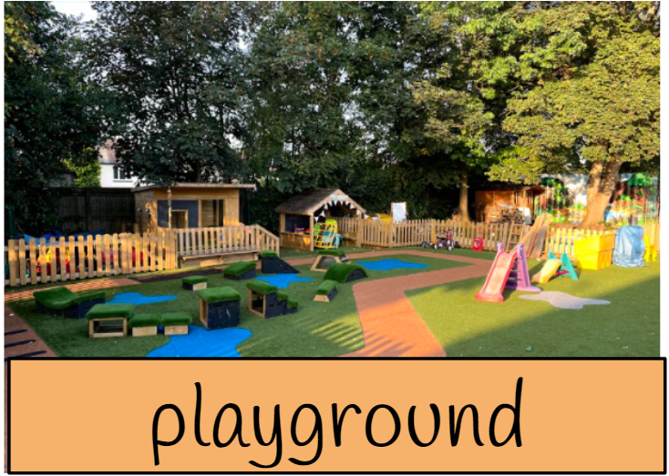
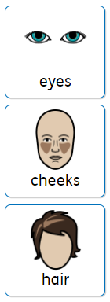
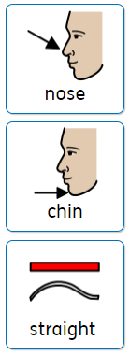
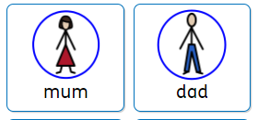
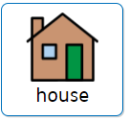
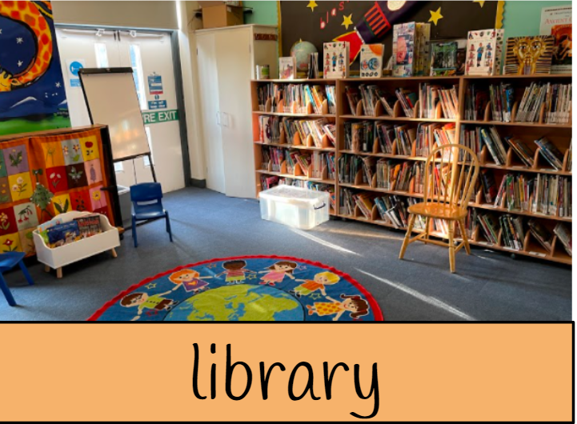
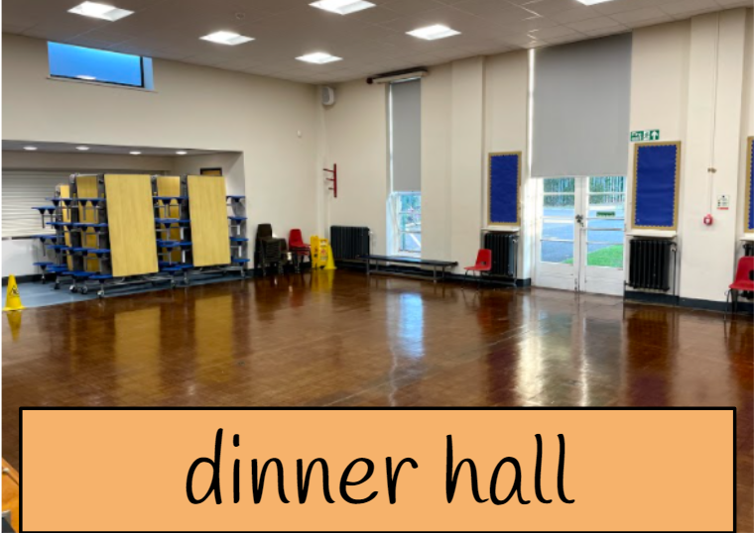
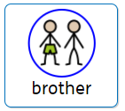
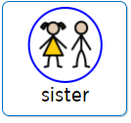
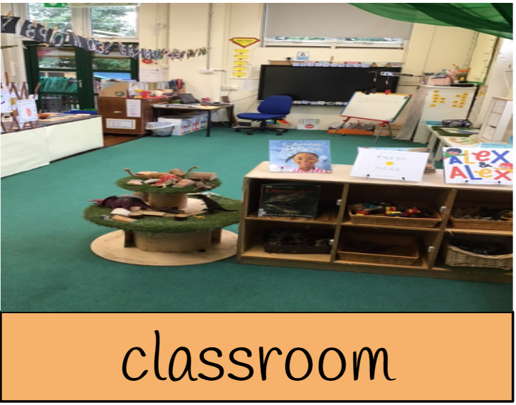
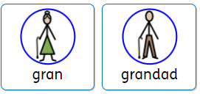
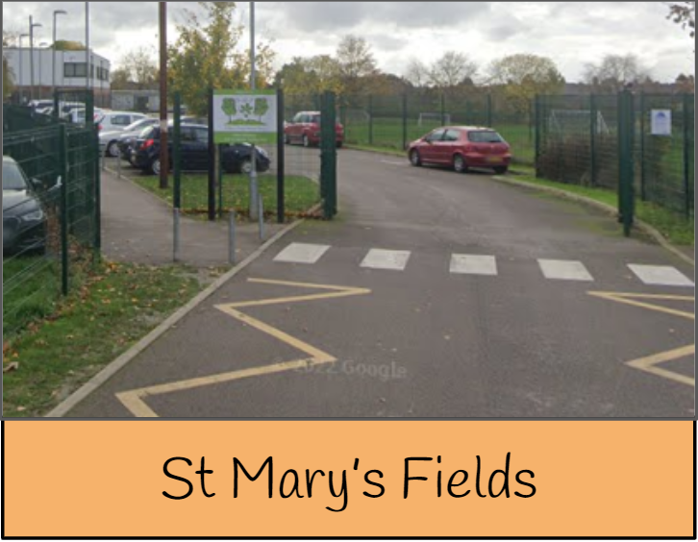
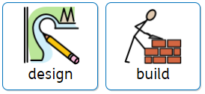
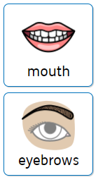
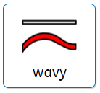
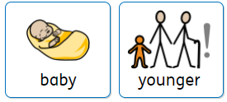
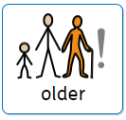
F2: Autumn 1: It’s good to be me (Hawthorn / Rowan)
1)Can I answer questions about my school? | 2) Can I talk about what makes me special? | 3)4))Can I tell you who is in my family? | 5)6)Can I talk about where I live and start to talk about my local area?

Slide 3
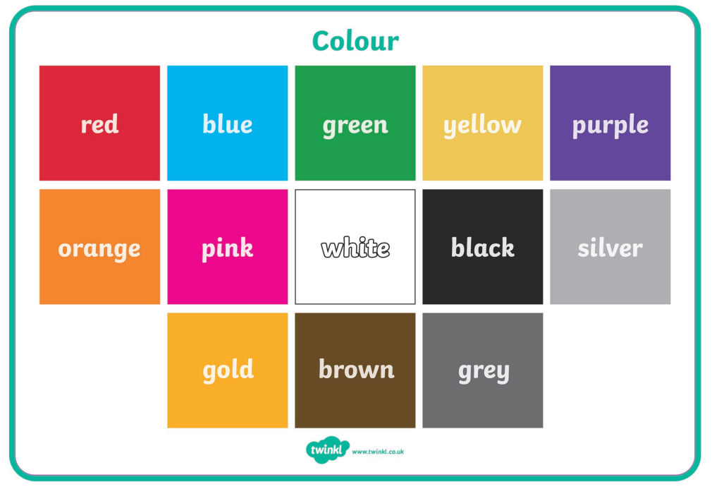
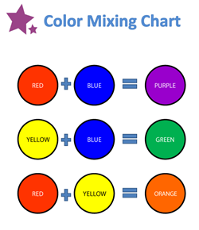
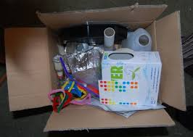
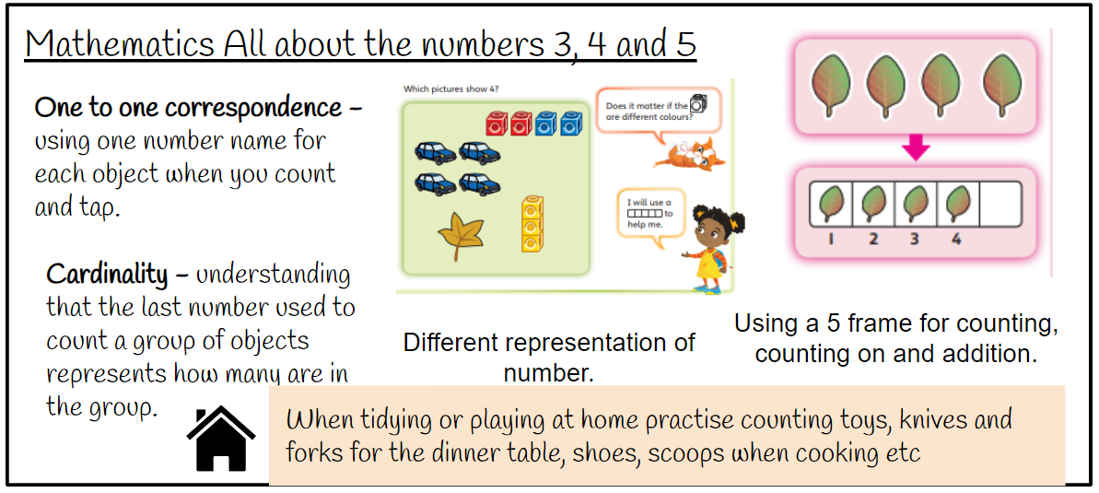
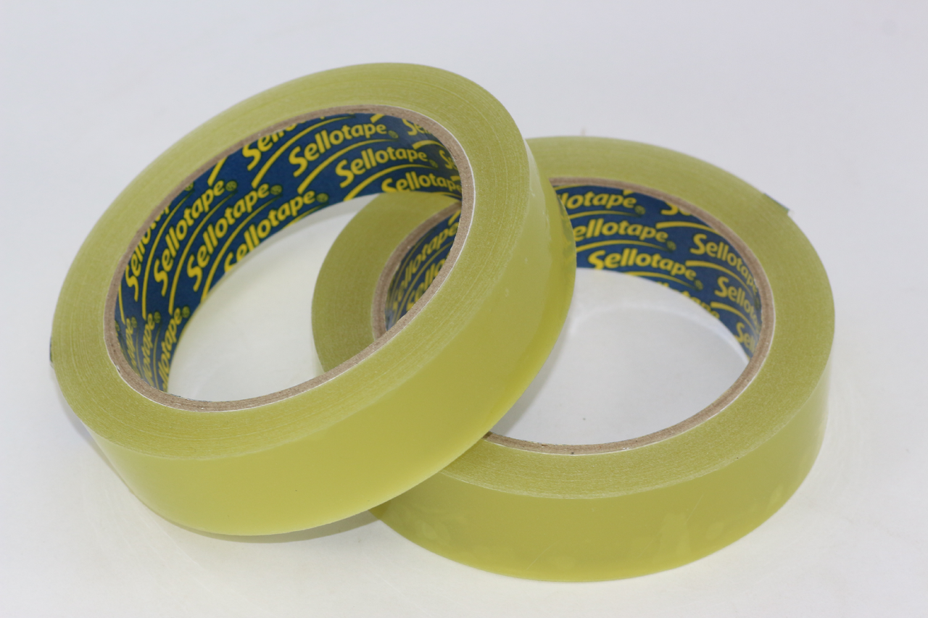
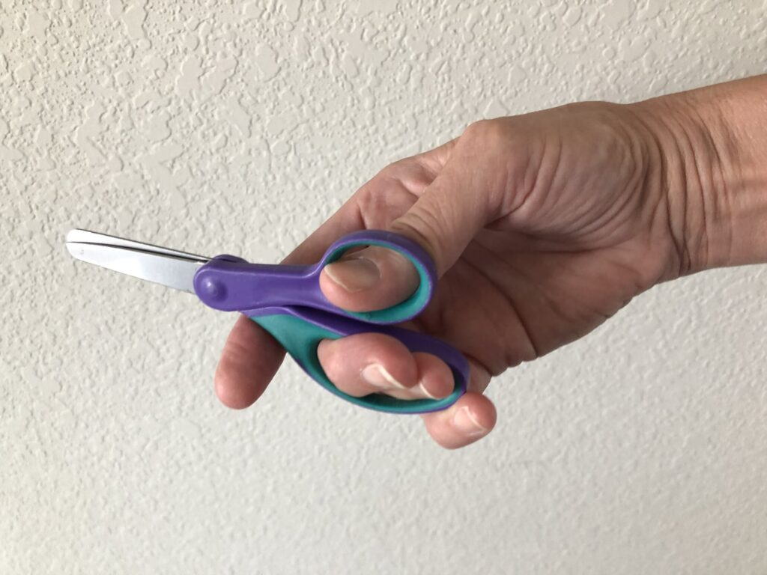
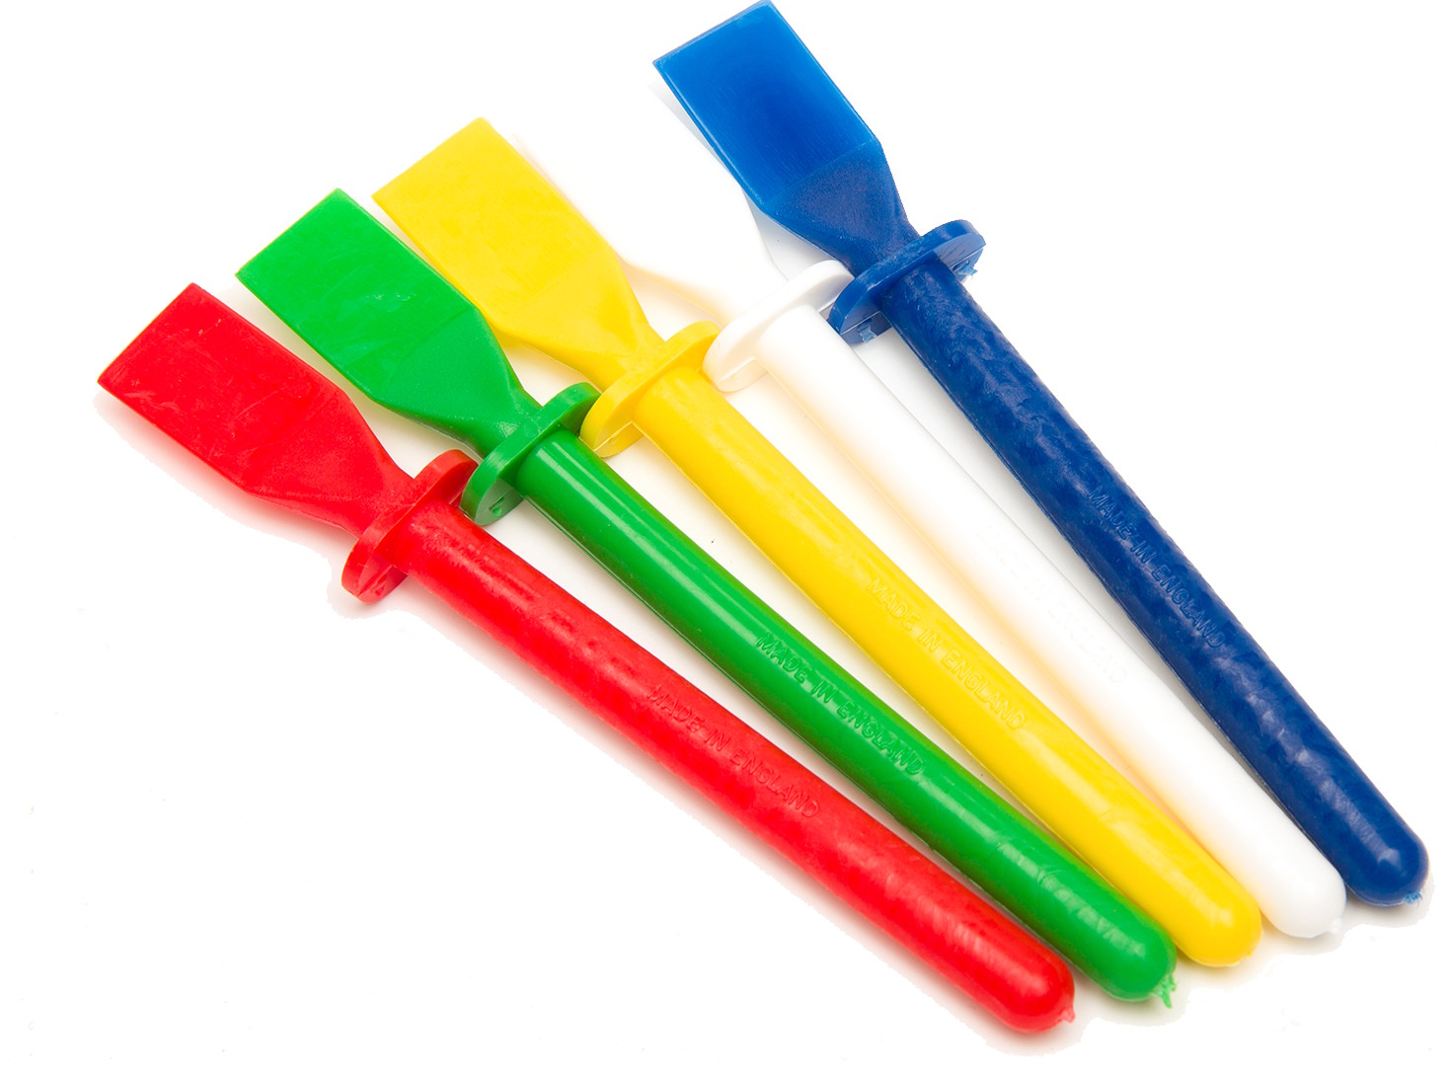
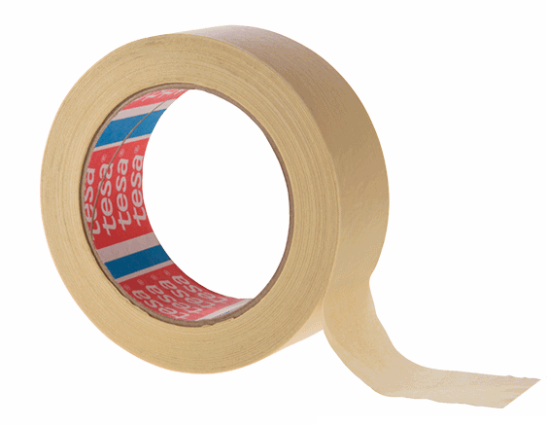
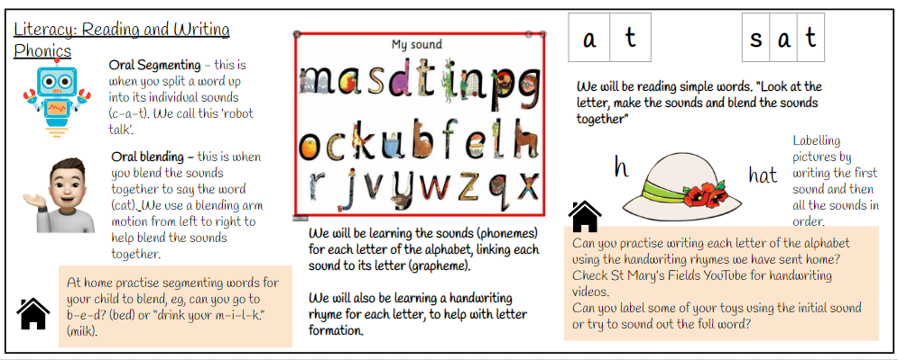
Key Vocabulary:
Music: Pulse : the regular heartbeat of a piece.
I can keep a steady pulse with some accuracy.
I can imitate movements in response to music.
Physical Development: Gross and Fine motor Skill
Lline Dancing: Gross and fine motor movement using wavy lines, zig zag lines and arches.
Dough Disco : Fine motor control using dough to practise squeezing, balling the dough, separating each finger to push the dough and also rolling a sausage shape.
Physical Development - Spatial awareness
We will be playing listening and attention games PE that will involve the children negotiating the space around them, carefully changing direction etc. Further develop the skills they need to manage the school day successfully:
lining up and queuing, mealtimes, personal hygiene.
Expressive Arts and Design: Art
Painting and drawing focus: using colours for a purpose and specific tools for using lines and circles to represent shapes and objects. \
We will be choosing colours for a purpose when we are learning how to draw a self portrait. c
D&T: We will be learning how to use junk modeling to make a model. We will also be practising our scissor skills.
run
jump
Expressive Arts and Design: D&T
We will be exploring junk modelling, attachment and scissor skills.
turn
scissors
balance
sellotape
Glue spreader
masking tape
PSED: Everyone’s Welcome
Red Rockets: Respectful friendships.
What would life be like if we all liked the same things?
Rainbow Jelly
Respectful friendships.
Is it ok to be different?
PSED: RE:
People who are special to us!
Family, Friends, Role Models.
Tripod pencil grip

