Slide 1

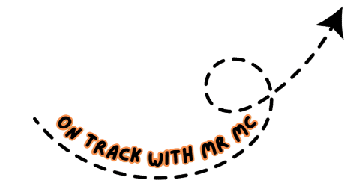
Guess the song

Slide 2
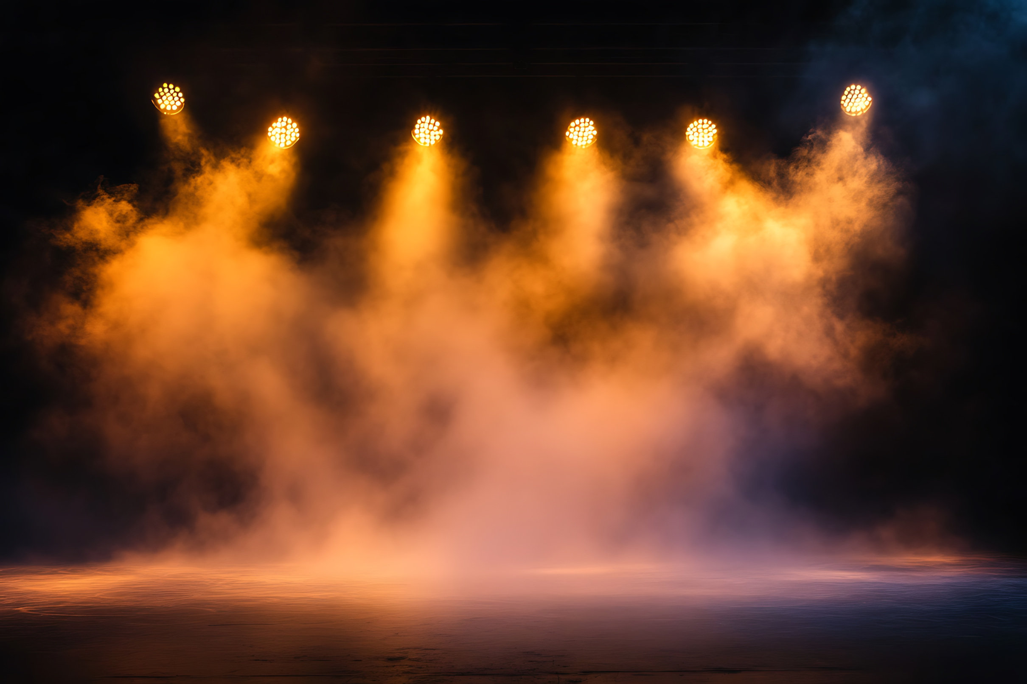
Sweede Carrot Lime

Slide 3
Sweet
Neil Diamond

Slide 4
Darn Zinc Kween

Slide 5
Dancing Queen
Abba

Slide 6
Stai In Uh Lighv

Slide 7
Stayin’ Alive
The Bee Gees

Slide 8
Eye Wont Two Braie kfrea

Slide 9
I want to break free
Queen

Slide 10
Eye Wont Tuh Hoeld Yer Hannd

Slide 11
I want to hold your hand
The Beatles

Slide 12
Gudd Vy-Bray-Shunz

Slide 13
Good Vibrations
The Beach Boys

Slide 14
Kall-ay-For-Nyuh Dree-Min

Slide 15
California Dreamin’
The Mamas and the Papas

Slide 16
Ree Spe kt

Slide 17
Respect
Aretha Franklin

Slide 18
Boh ee Mee Un Rap Suh Dee

Slide 19
Bohemian Rhapsody (Queen)

Slide 20
Sew pur stis hun

Slide 21
Superstition
Stevie Wonder

Slide 22
Uh mayor ikun pigh

Slide 23
American Pie
Don McLean

Slide 24
Bee tit

Slide 25
Beat it
Michael Jackson

Slide 26
Evrib reth yewt ayk

Slide 27
Every Breath You Take The Police

Slide 28
poor paul ray nn

Slide 29
Purple Rain
Prince

Slide 30
One derwal

Slide 31
Wonderwall
Oasis

Slide 32
one uh bee

Slide 33
Wannabe
Spice Girls

Slide 34
Maih art wyl goh on

Slide 35
My Heart Will Go On Celine Dion

Slide 36
Baib ee wun mort ighm

Slide 37
Baby One More Time Britney Spears

